Slide 1
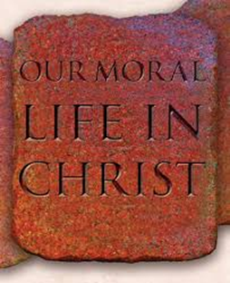
CHAPTER 1: The Gift of Being Human

Slide 2
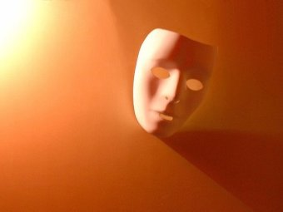
Who are you?

Slide 3
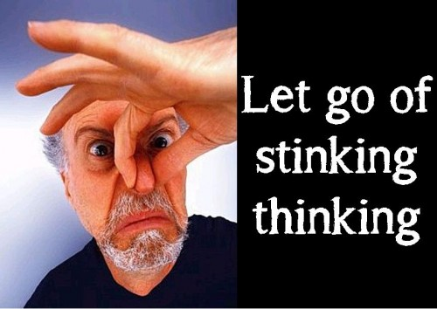

Slide 4
Counteract Stinkin Thinkin
Everyone doesn’t have to like us.
It’s okay to make mistakes.
Other people are okay; so are you.
You don’t have to control everything.
We are responsible for how we feel and what we do.
It is important to try.
We are capable and can change. The same is true of others.
We can be flexible.

Slide 5
Serenity Prayer
God grant me the serenity
to accept the things I cannot change;
the courage to change the things I can;
and the wisdom to know the difference.
Living one day at a time;
enjoying one moment at a time;
accepting hardships as the pathway to peace;
taking, as He did, this sinful world
as it is, not as I would have it;
trusting that He will make all things right
if I surrender to His Will;
that I may be reasonably happy in this life
and supremely happy with Him
forever in the next.
Amen.

Slide 6
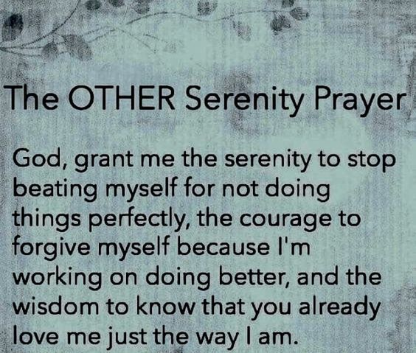

Slide 7
God is the Creator
God didn’t have to create us … but did
God always keeps us in existence
We are NOT God – don’t forget that
We should take our place in God’s creation

Slide 8
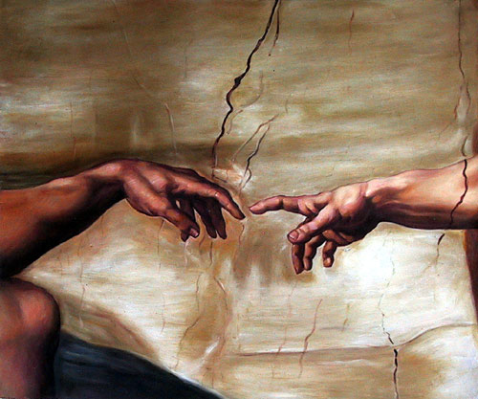
Our place in Creation
We are the ONLY creatures on earth that God willed for their own sake
We are created to return God’s love and to serve him

Slide 9
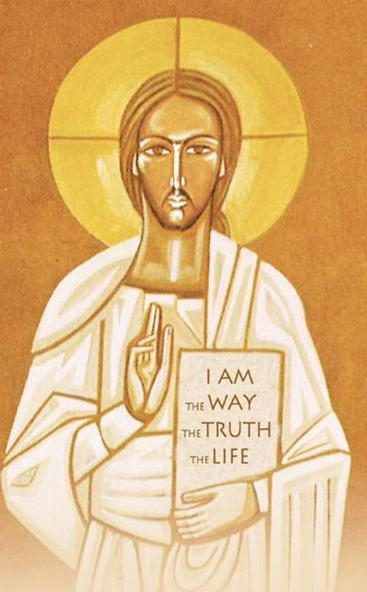
God makes us in the Divine Image
We have god-like qualities:
To think
To choose
To love
To relate to others
We are not ‘somethings’ … we are someones!

Slide 10
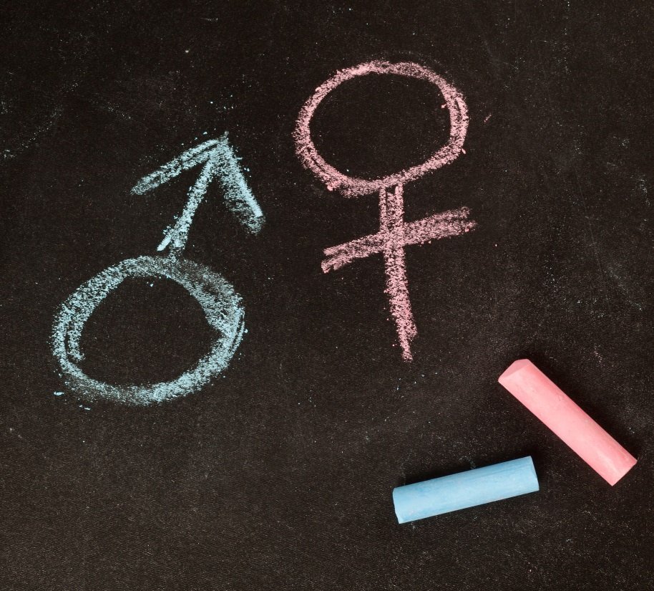
God made us …
… male and female,
complimentary to one another,
with equal dignity
Sexual beings with both a spirit and body

Slide 11
Human Dignity
‘The state or quality of being worthy of honor or respect.’
A quality of being worthy of esteem and respect. Having worth and value.
Not earned, but rather …
Inherent – we’re human
Inviolable – no one has a right to violate or disrespect it
Inalienable – cannot be taken away

Slide 12
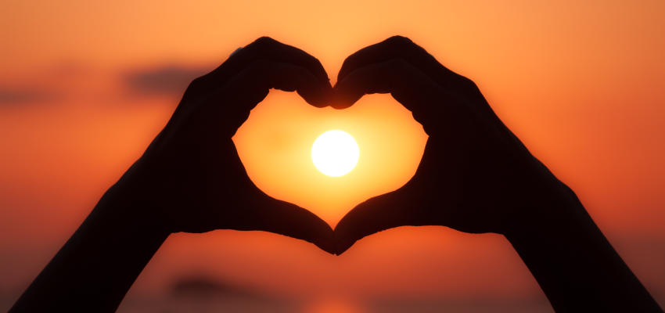
Human Dignity
We love because he loved us first 1 John 4:19

Slide 13
Human Dignity
Doesn’t depend on any externals
Comes from our relationship with a God who is madly in love with us, and who created us out of that love
We are a SOMEONE not a SOMETHING
The cornerstone of morality and Christian ethics

Slide 14
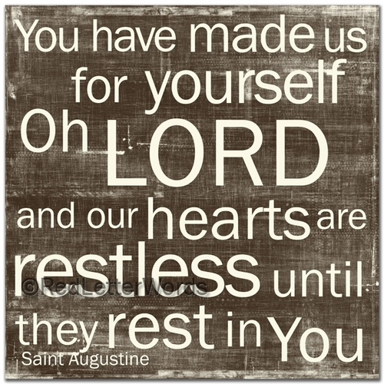
Our Spiritual Nature
Our dignity has been restored by Jesus’ death
Our spiritual nature leaves us restless to understand more about our existence

Slide 15
Think and reason – we are rational beings
Discover truth
Recognize God’s voice
Free Will – the capacity to choose among alternatives
Ability to love
Be responsible
Capacity to grow

Slide 16
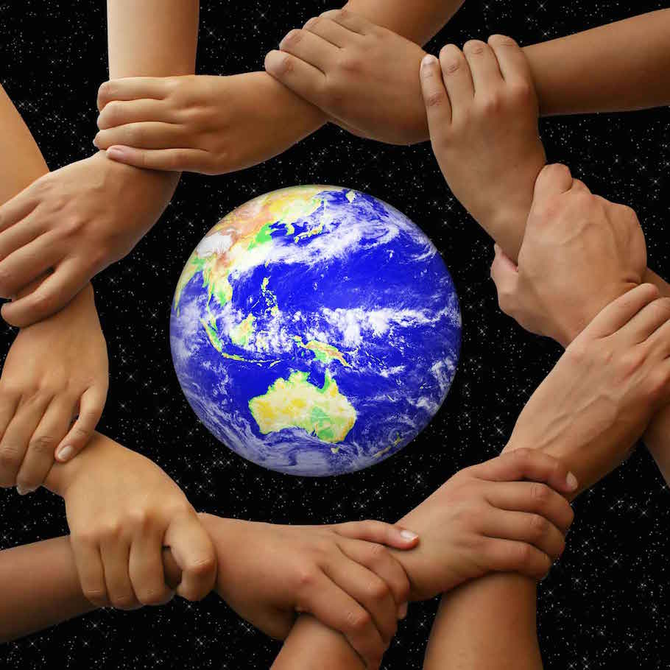
Subsidiarity
A community of higher order should not interfere in the life of the community of lower order
The Common Good
Solidarity
Christian virtue of social charity or friendship

Slide 17
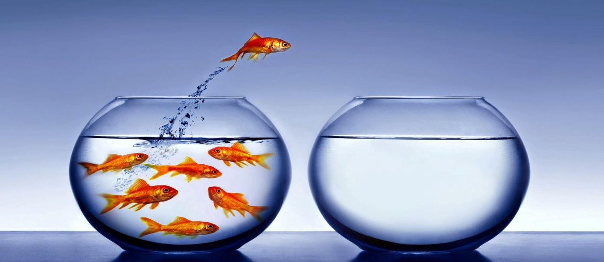
If it’s true that God gave us the gift of free-will, true freedom, then why can’t we decide for ourselves what is right and wrong?
When I choose wrong, or when bad things happen, why doesn’t God stop me?

