Slide 1
Chapter 2
Making
Moral Decisions

Slide 2
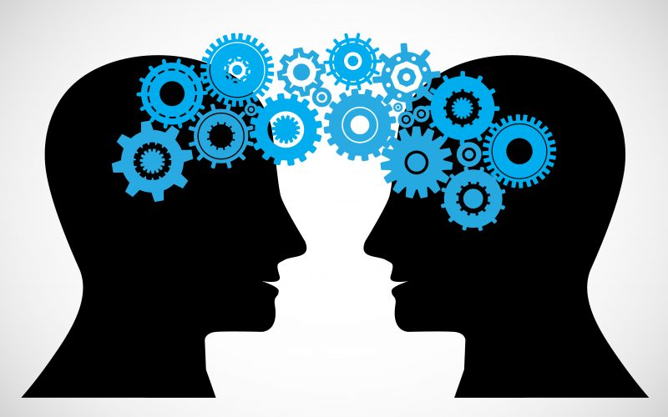
Think
Discern
The ability to judge well

Slide 3
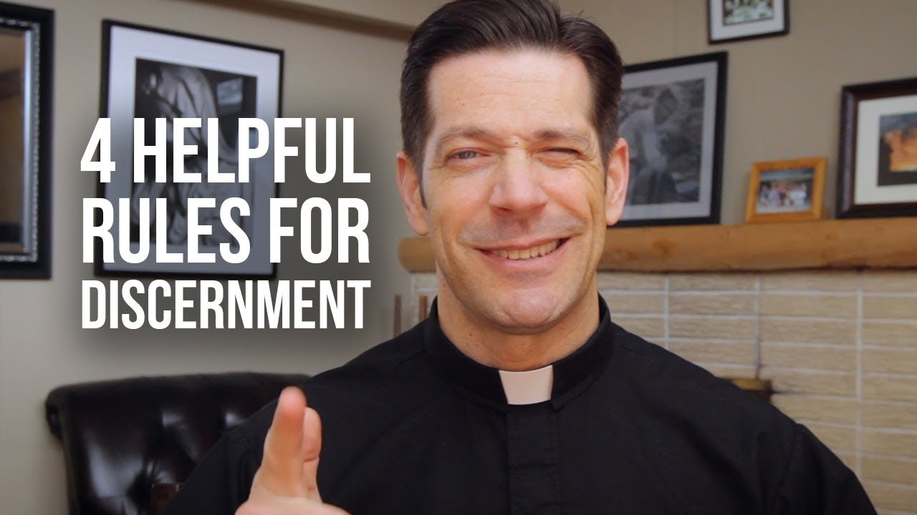
Is this a good ‘door’ for me to open?
Is that door even open to me?
If it’s open to me, is this a wise door for me to open?
If it’s good, open, wise … is this even a door that I want to open?

Slide 4
Prudence ….
Right reason in action (Aquinas)
Governs other virtues
Sets rules and boundaries
Correct judgement
Helps form conscience
Is necessary for correct judgement

Slide 5
What will I do with my life? I see myself as …. ?
I’m leaning toward career decisions …
What are they?
Why do they attract you?
How can I prepare myself (as a sophomore) for this becoming a possibility for me?
I have no clue what I want to do …
What can I do to close the gap on my future?
Who can I talk to?
How can I begin this process?

Slide 6
Search out all the facts
Think about alternatives and consequences
Others – consult them and consider how your actions will affect them
Pray to the Lord for guidance

Slide 7
Search out all the facts

Slide 9
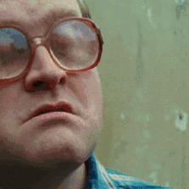
Moral Object .. the what?
The object, intention, and the circumstances make up the ‘sources,’ or constitutive elements, or the morality of human acts. (CCC, 1750)
The ‘what’ or ‘matter’ of the moral issue
If we get the WHAT wrong … the how, when, where and who don’t matter much
THE MORAL OBJECT (THE MATTER) IS THE DECISIVE ELEMENT IN MORALITY

Slide 10
The Moral Object …
The act/action = the physical act, the doing
Moral object = the end, the outcome toward which the act itself is inherently directed
The act = abortion
The end = pregnancy is terminated
The moral object is not necessarily the end chosen by the person who acts as the intended end or purpose. Rather, it is independent of intention, e.g. preventing another poor child is still abortion!
Moral object determines if the action is good or bad → directed to our true good or towards destructive purposes.

Slide 11
A man with a wife a 3 children has gotten himself into trouble with a certain underground criminal organization. The man has fallen into debt but cannot pay it off. The organization has given him one month to pay the debt or else one of his family members will get ‘hurt’ in order to act as incentive to pay. The man decides to hire someone to burn down his house and collect the insurance money in order to pay off the debt. In the process the man’s wife was unknowingly home and dies in the fire.
What is the moral object?
Does it serve the good or the bad?

Slide 12
The Moral Object …
The moral object, or the outcome, is the death of his wife and lying (attempted fraud) thus the moral object does not serve the good of humanity.
If the man were in a rational state he would not have hired the man to burn down his house, or get involved with these people.
The man would have searched for other sources of income before he even went into debt.
The act itself is inherently evil because the inherent outcome involved lying (and subsequently death).

Slide 13
The Moral Object …
The moral object, or the outcome, is that Jennifer lied to her mother and went to the party, thus the moral object (lying) does not serve the good of humanity.
If Jennifer would have considered the alternatives, she may have reached a compromise with her mother.
Perhaps the consequences led to her feeling little or no risk in lying.
The act (going to the party) itself may not appear inherently evil, but the outcome involved lying (and subsequently violating her mother’s trust), and thus is morally wrong.

Slide 14
Intention … the why?
Once I get clarity on the ‘what’ .. then ‘why’ does it matter?
Involves our MOTIVES or INTENTIONS
What are we trying to solve for?
Collective intention – a series of actions
One action can be motivated by several intentions

Slide 15
Rules – Managing Intentions
Keep the intention GOOD
The end doesn’t justify the means

Slide 16
Morality = involves human acts (informed choices)
A human act = an exercise of intellect (reason) + free will
Mind (intellect) = understands
Will = freely chooses
Intellect + will = KNOWING CHOICE
Knowing choices are subject to God’s moral law
Moral = permissible, not sinful
Immoral = not permissible, sinful

Slide 18
Who, where, when, how?
Consequences matter!
Can affect the moral goodness/evil of an act
May affect our responsibility for our actions
Circumstances matter!

Slide 19
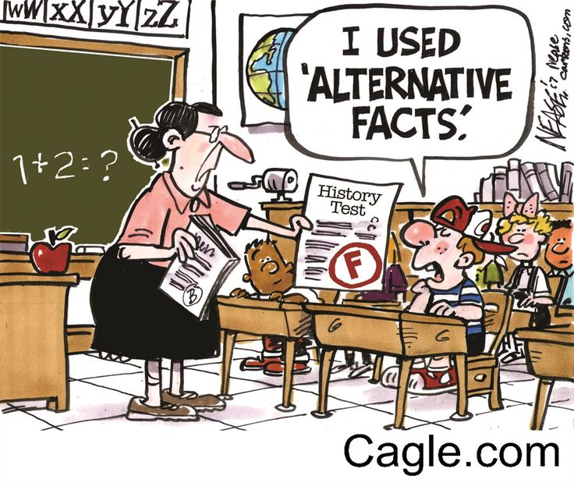
… don’t forget the Alternatives

Slide 20
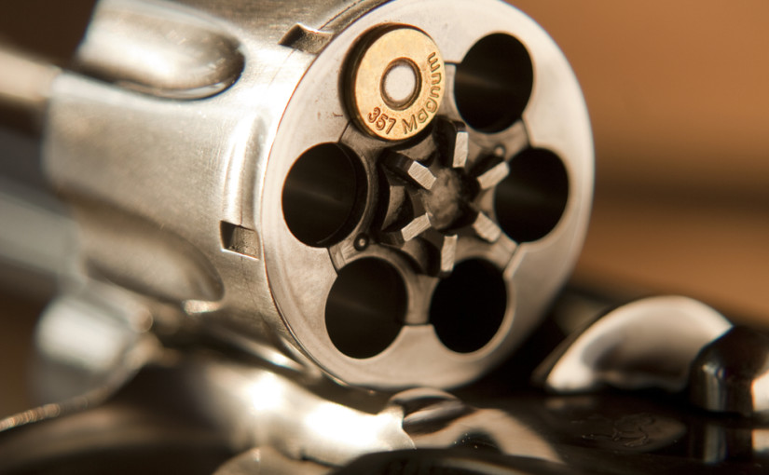
Consequences …

Slide 21
Search out all the facts
Think about alternatives and consequences
Others – consult them and consider how your actions will affect them
Pray to the Lord for guidance

Slide 22
Others …
Who will be affected by your decision?
How will your decision affect them?
Who else might you talk to to gain insight into your decision?

Slide 23
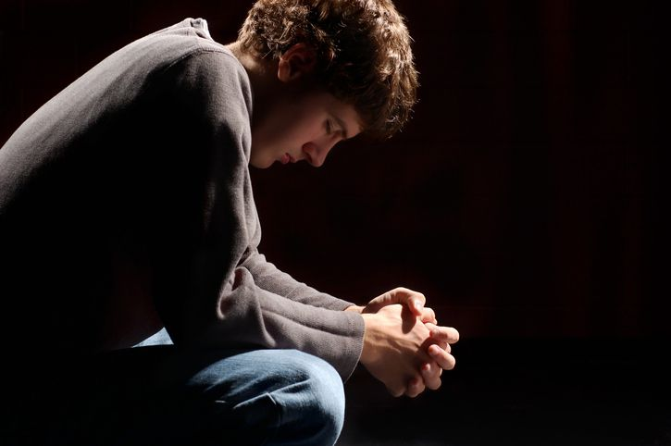
Prayer …
What would you ask God for?
What would affect your asking God to help you?
What might
your prayer
be?

