Slide 1
Law as a Guide to Freedom
Chapter 3

Slide 2
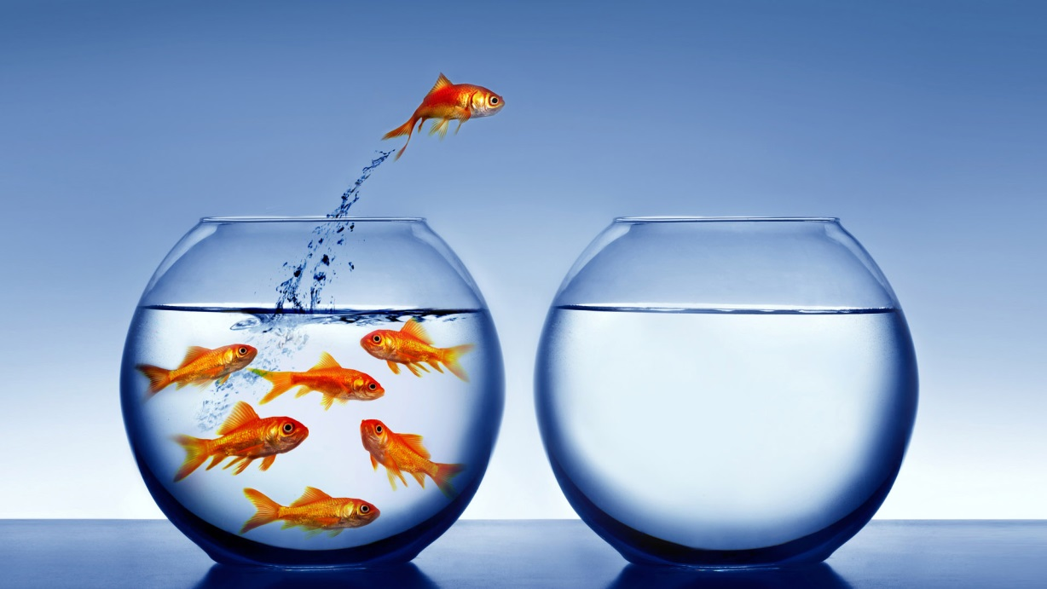
Freedom
Responsibility
Law

Slide 3
YOUR FREEDOM …
What is the greatest gift of your freedom?
What is the greatest risk to your freedom?

Slide 4
If someone gets raped, we blame the rapist …
If someone gets robbed, we blame the robber ..
If someone gets scammed, we blame the scammer …
But if someone gets shot, we blame the gun …

Slide 5
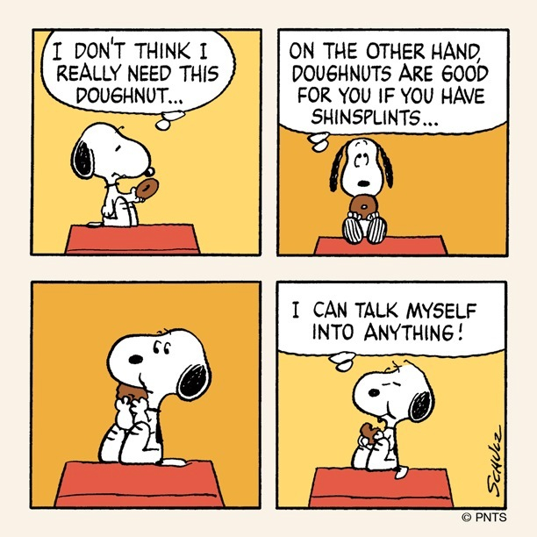
RATIONALIZATION: The fine art of making excuses for one’s behavior

Slide 6
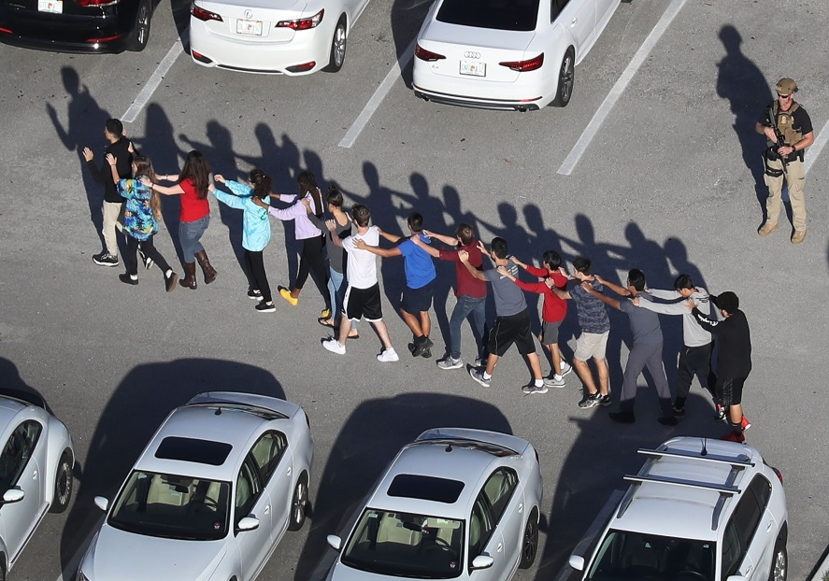
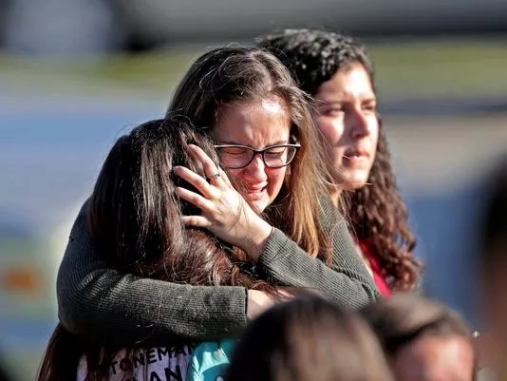
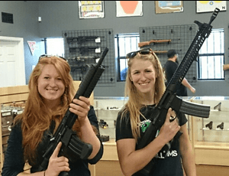
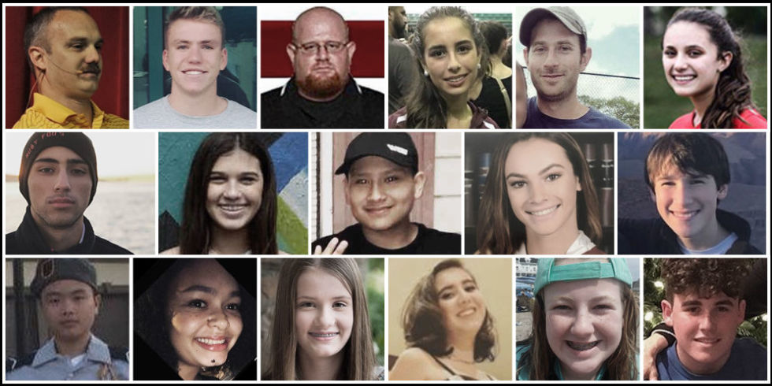
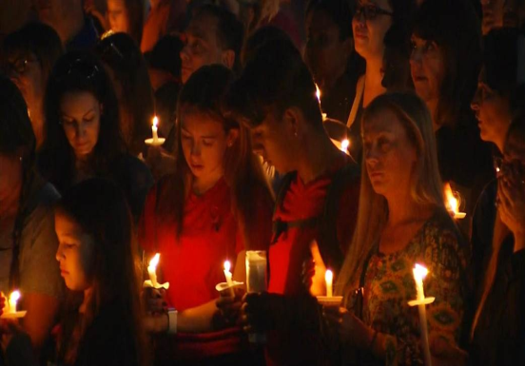
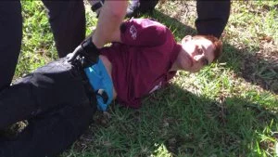
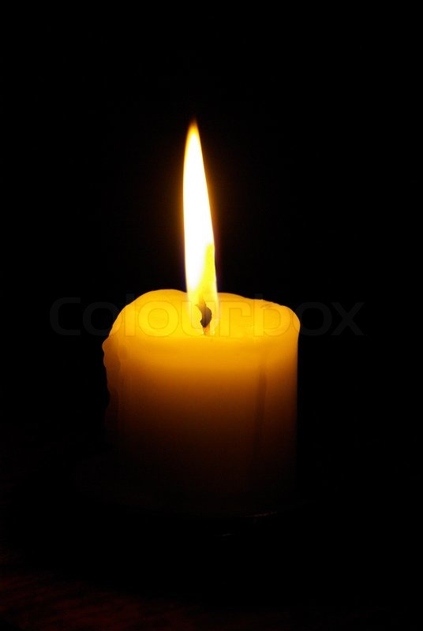
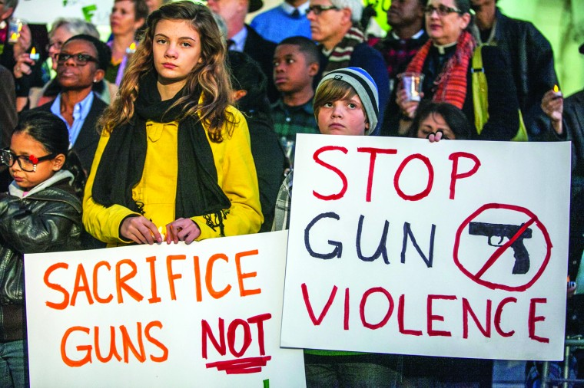
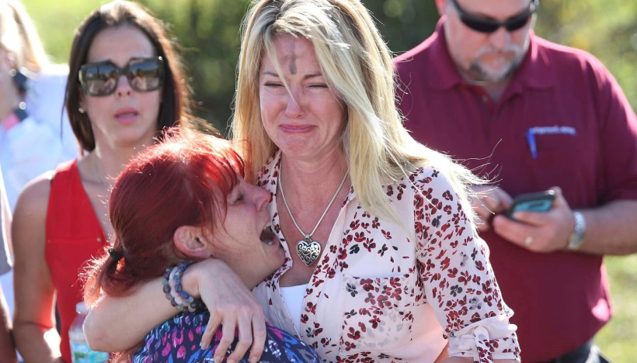

Slide 7
Do I ‘own’ my poor moral choices, or do I make excuses and try to pass the blame?
Would having less freedom in my life provide me with more security, and thus more happiness?
Do I have too much / not enough freedom to enable me to make good moral choices? Why?

Slide 8
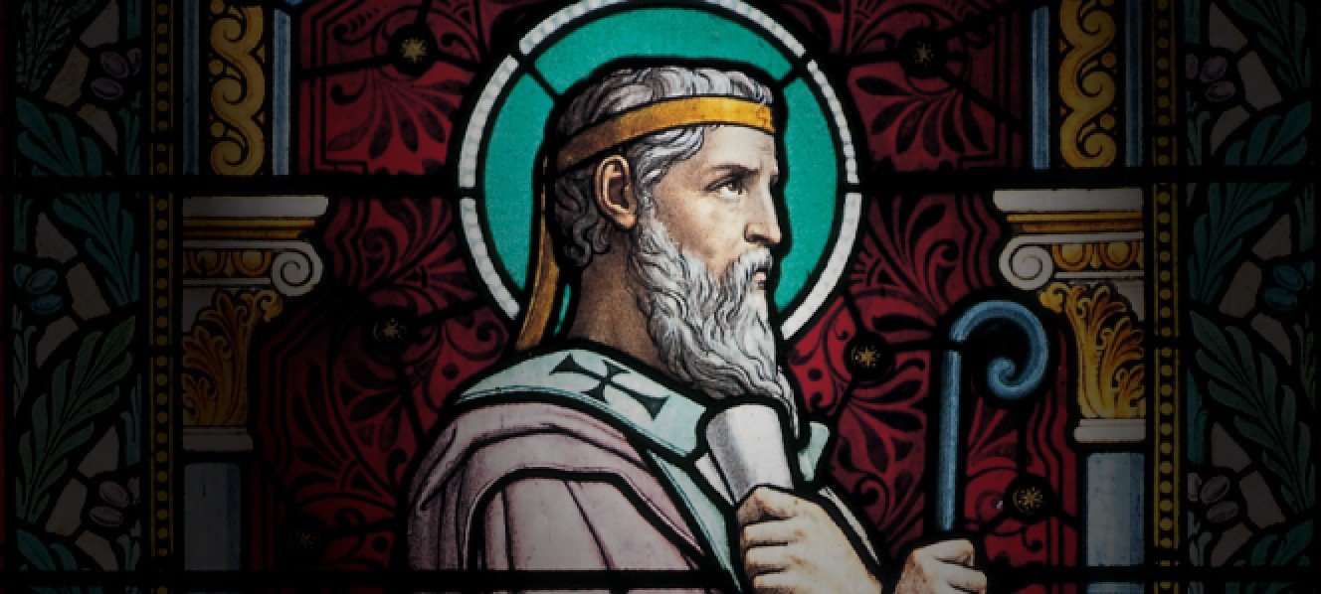
“Man is rational and therefore like God; he is created with free-will and is master of his own acts.” St. Irenaeus

Slide 9
Freedom
Responsibility
Law

Slide 10
“… the power, rooted in reason and will, to act or not to act, to do this or that, and so to perform deliberate actions on one’s own responsibility.” CCC #1731
DEFINED …

Slide 11
Fundamental truths about FREEDOM
Humans have the powers of reason and free-will
Because we are free, we have the ability to love
Freedom makes us responsible for our choices and actions
Because humans do have freedom, we are self-determining … and can select our own goals and plan to accomplish them

Slide 12
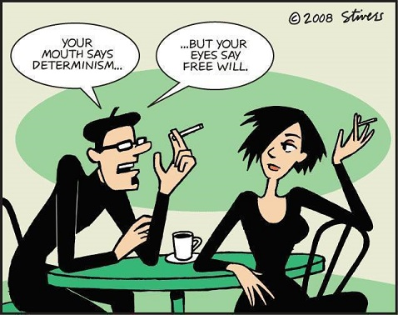
Determinism: the rejection of the notion that human beings have the power to choose due to circumstances outside the human will.

Slide 13
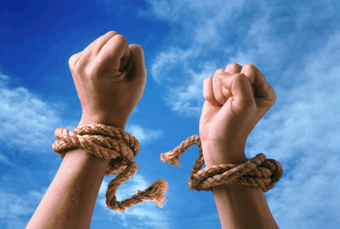
External: Freedom from factors OUTSIDE us that threaten or destroy our power to choose
Internal: Freedom from interior influences that limit choice
KINDS OF FREEDOM

Slide 14
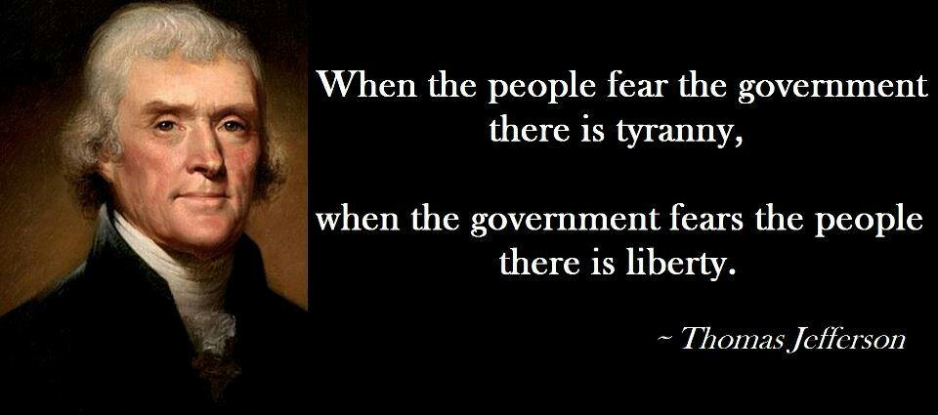
LICENSE: Unlimited or unrestricted freedom that abuses liberty

Slide 15
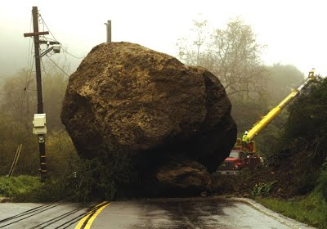
Impediments
to Freedom
Limit our ability to
use freedom
Ignorance Inadvertence | Duress Inordinate attachments | Fear Habit

Slide 16
Responsibility
Response -
my ‘yes’
Ability ..
my freedom

Slide 17
Imputable
RESPONSIBILITY = FREEDOM

Slide 18
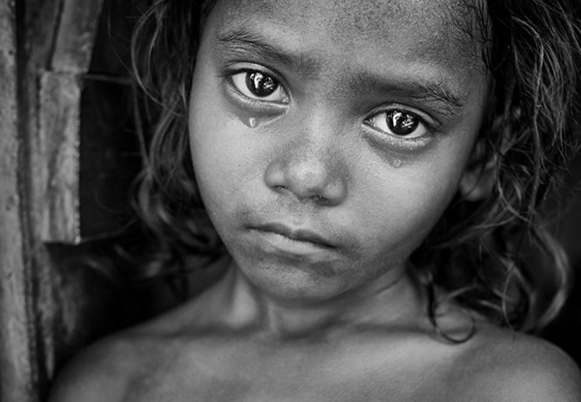
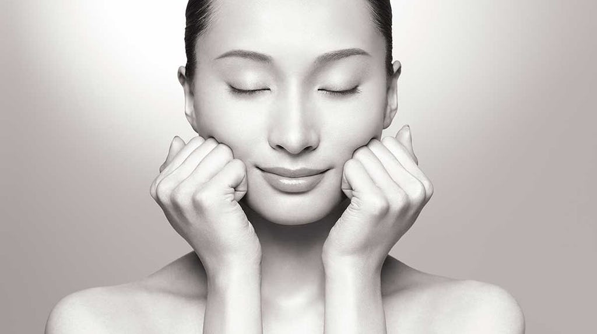
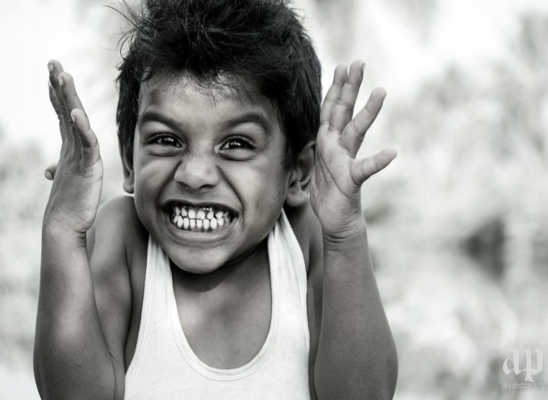
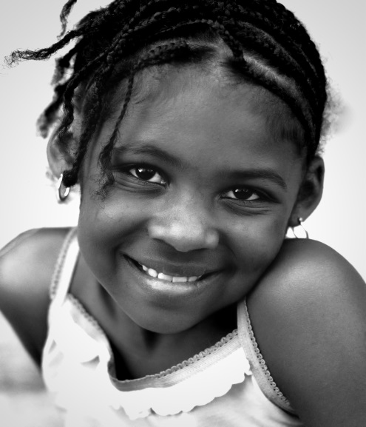
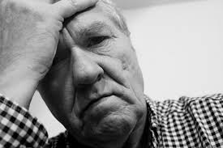
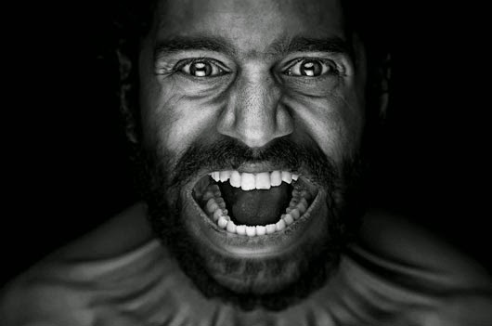
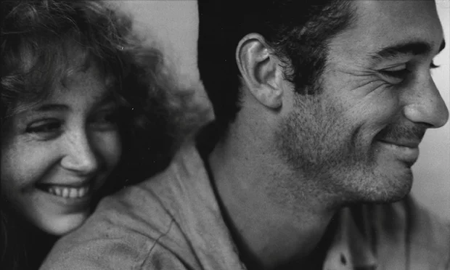
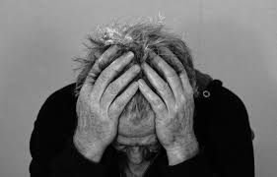
EMOTIONS

Slide 19
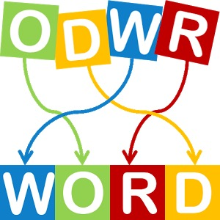
EW DENE ODOG AWL ROF A ODOG FILE
We need good laws
for a good life

Slide 20
It is illegal in Michigan to hitch a crocodile to a fire hydrant.
In Michigan a woman isn't allowed to cut her own hair without her husband's permission
In Ohio, it is illegal to get a fish drunk
It is illegal to take a bath in the wintertime in Indiana
Chicago law prohibits eating in a place that is on fire

Slide 21
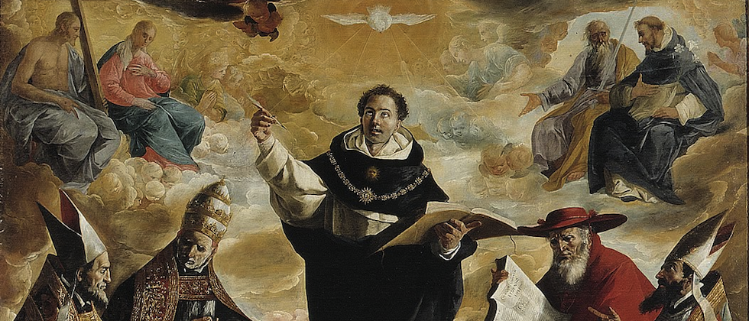
St. Thomas Aquinas
(b. 1225, d. 1274)

Slide 22
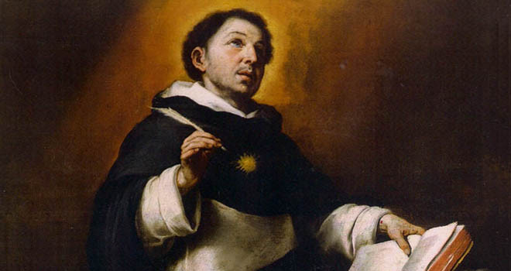
Law Defined
An ordinance of reason for the common good, promulgated by the one who is in charge of the community. St. Thomas Aquinas, CCC, 1976

Slide 23
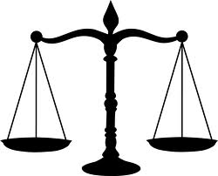
4-ELEMENTS
OF AQUINAS’ DEFINITION
OF LAW
Law is reasonable
Laws are for the common good
Competent authority makes laws
Laws must be promoted

Slide 24
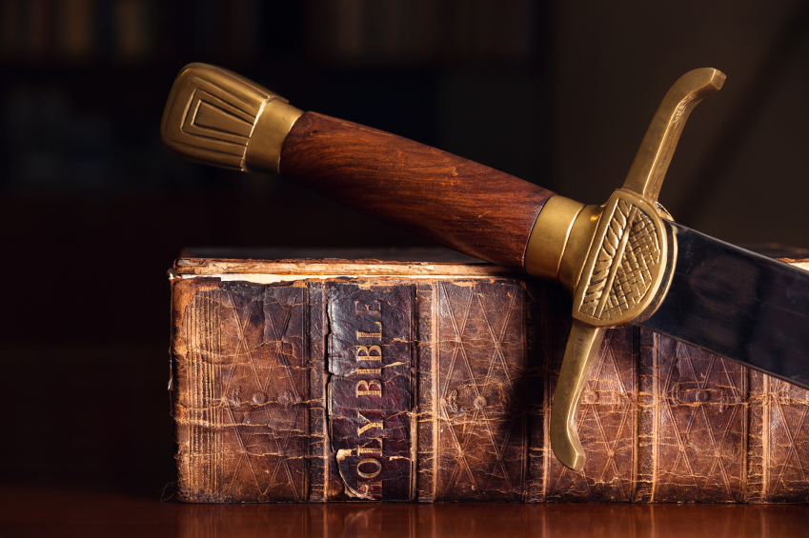
5-Interrelated Expressions
of the Moral Law
Natural Law
Civil Law
The Old Law
The New Law (Gospel)
Church Laws

Slide 25
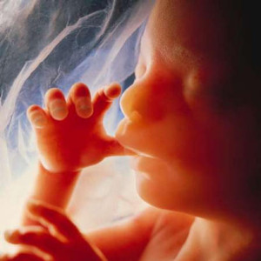
It all begins with God’s Divine Law …
God’s loving plan for his creatures

Slide 26
4 PURPOSES OF THE
DIVINE LAW
Helps us stay on the right path on our journey to God
Helps us discern what is right when there are conflicting ideas of right and wrong
It speaks of our motivation
It indicates what is sinful – kills or injures our relationship with God and others

Slide 27
NATURAL LAW
FOCUSED ON
HUMAN DRIVES:
Preserving life
Personal and Social Development
Sharing life with others

Slide 28
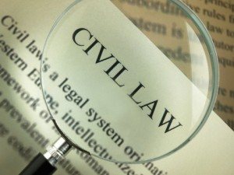
Particular application of the natural law for members of a given society
Good only if it conforms to God’s divine law

Slide 29
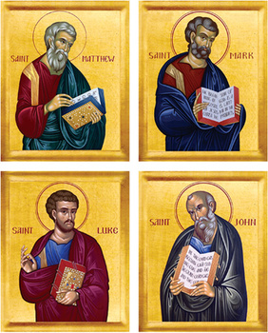
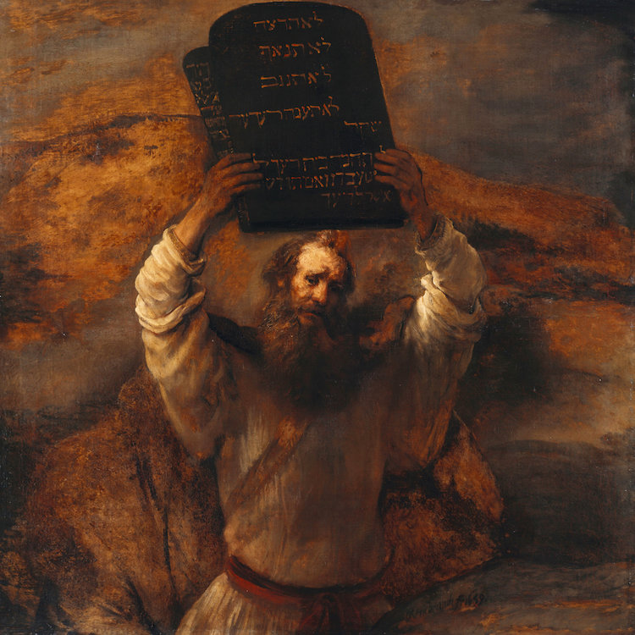
THE OLD LAW
The first stage of revealed law
THE NEW LAW

Slide 30
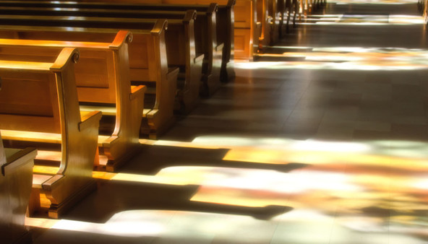
CHURCH LAW
SIX PRECEPTS OF THE CHURCH
Attend Mass on Sundays and holy days of ‘opportunity’
Participate in Reconciliation at least once a year
Receive the Eucharist at least during the Easter Season
Keep the holy days of ‘opportunity’
Observe the prescribed days of fasting and abstinence
Provide for the needs of the Church

