Slide 1
The Coming of a Messiah
CHAPTER THREE

Slide 2
Lectio Divina
Lt. = Divine Reading
We enter the story by identifying with one of the characters
Can help us identify Gospel stories with everyday life
Four steps:
Reading (lectio)
Meditation (meditatio)
Contemplation (contemplatio)
Prayer (oratio)

Slide 3
For starters …
What does the word gospel (Gk., evangelion) mean? “good news”
Gospels focus on what three things:
Jesus himself (of course!)
The message of salvation he proclaimed
Written records of the ‘Good News,’ accomplished in Jesus, and recorded through the perspective of four different lenses.

Slide 4
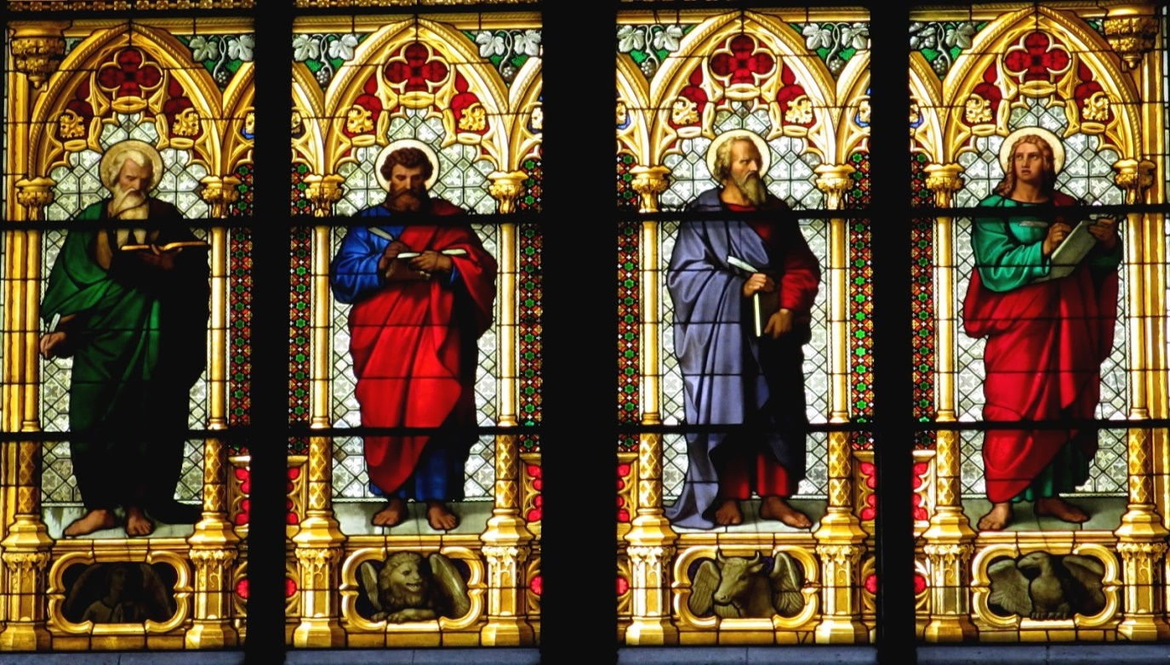
Function of the Gospels
They announce the Good News of Jesus
They provide an encounter with Jesus
They challenge us to believe in Jesus

Slide 5
Non-Apocryphal
Apocryphal: ‘of doubtful authenticity’
Which Gospels are considered ‘non-apocryphal?’
Matthew
Mark
Luke
John
Were there other, ‘apocryphal’ gospels as well?
Yes, many!

Slide 6
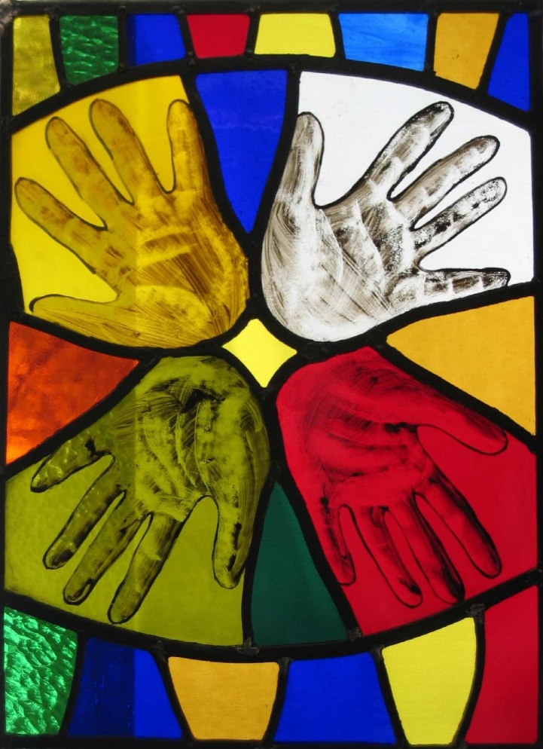
Gospel Factoids …
NOT biographies …
ARE testaments of faith
Synoptic = looking together; side-by-side
Mark
Matthew
Luke
First: Mark (70AD)
Last: John (90-100AD)
Shortest: Mark
Most theologically developed = John
Most polished, inclusive, sensitive = Luke
Illustrate the Paschal Mystery

Slide 7
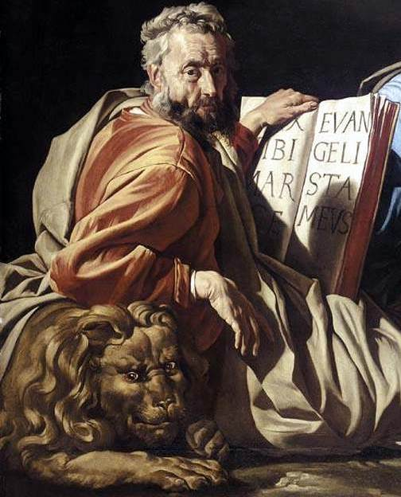
Mark
‘John Mark’ from Acts
Companion of Paul and Barnabas
A ‘home body’
Close relationship with Peter, whom he called, ‘his son’
Lived in Alexandria (Egypt)- first bishop
Martyred – dragged through the streets
Gospel = 60-70AD based on teachings of Peter
Matthew and Luke relied on it
Notes:
Mark joined St. Paul and St. Barnabas on their first missionary journey to Antioch in 44 A.D. When the group reached Cyprus, Christian tradition holds that Mark left them and returned to Jerusalem, possibly because he was missing his home (Acts 13:13). This incident may have caused Paul to question whether Mark could be a reliable missionary. This created a disagreement between Paul and Barnabas and led Paul to refuse Mark's accompaniment on their second journey to the churches of Cilicia and the rest of Asia Minor.
However, it can be assumed the troubles between Paul and Mark did not last long, because when Paul was first imprisoned, Mark, who was at the time in Rome with plans of visiting Asia Minor, visited him as one of his trusted companions (Col 4:10).

Slide 8
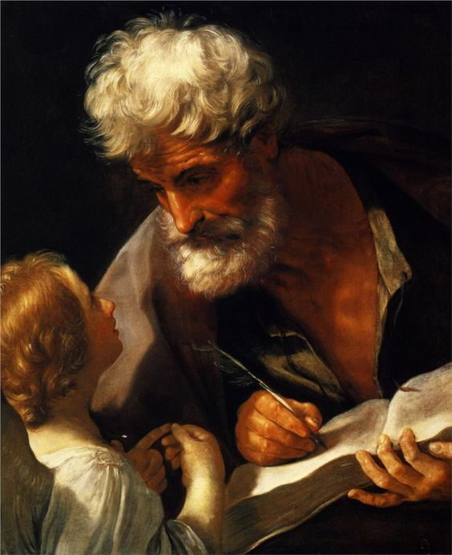
Matthew
Born in Judea
A tax collector – despised by his own
Invited Jesus home for a dinner – Jesus was criticized for eating with sinners
Never claims to be witness to Resurrection and Ascension
Preached the Gospel to Jewish-Christian community in Antioch
Jesus as ‘new Moses’

Slide 9
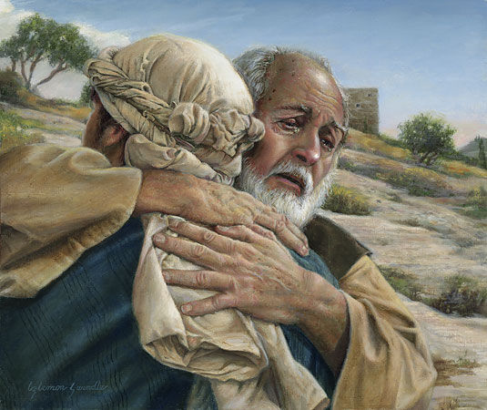
Luke
Born in Antioch
Gentile Christian writing from Greece for poor disenfranchised Gentile-Christian audience
Believed to be a physician
Disciple of Paul
Unmarried
Also authored Acts of the Apostles
Most inclusive and literary of Gospels
No concern in liking Jesus to Old Testament prophets

Slide 10
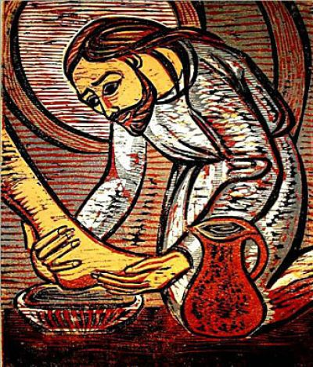
John
Born in 15 A.D.
Died 100 A.D.
Likely John the Apostle, the ‘disciple whom Jesus loved’
Only disciple not martyred, lived to an old age in Ephesus
Still matter of debate whether John the Evangelist is John the Apostle
Gospel of Light and Dark

Slide 11
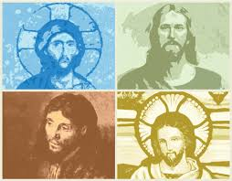

Slide 12
Jesus as human …
Jesus as HUMAN
Matthew 1:1
Jesus has a family
It all starts with an ancestral father … Abraham
Earthly mom and dad
Jesus gets his name

Slide 13
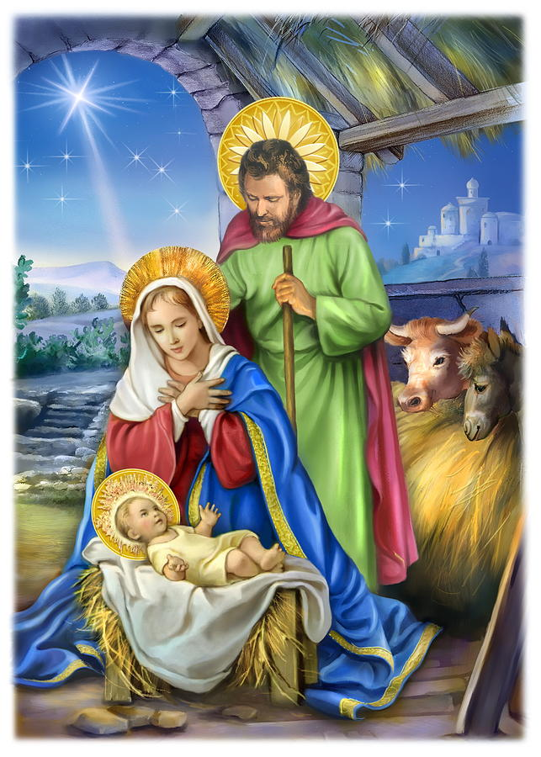
Jesus as divine …
Infancy narratives in Matthew and Luke ONLY
Jesus receives his name, ‘Emmanuel’ – God with us
Fulfillment of prophecies and Davidic covenant
Jesus’ birth a ‘divine action’
Matthew highlights Joseph’s role
Luke highlights Mary’s role
Role of angels

Slide 14
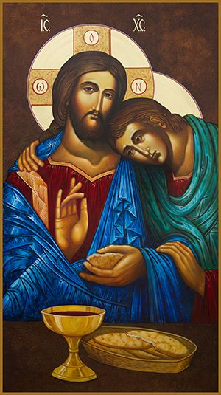
Who was John?
A Jew, a fisherman
Son of Zebedee, brother of James
Mother wanted he and James to sit a place of prominence with Jesus in heaven
Often John and Peter with Jesus at special moments
THEME: Jesus was the Son of God, the Divine Logos (Christ, anointed one)
Always God-like in control
Contrast of light vs. darkness
Creation happens when Jesus touches something or someone

Slide 15
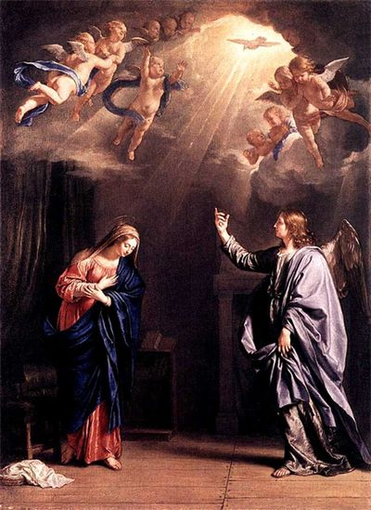
The Incarnation
A ‘dogma’ of our faith
John’s Prologue (1:1-18)
Word becomes flesh and dwells among us in the person of Jesus Christ
Another ‘birth’ in a sense
Another prologue, just like Luke
PURPOSE: To save us from our sins and reconcile us to God
Protoevangelium (Gen 3:15) is the promise of the Incarnation

Slide 16
Birth Narratives of Jesus
MATTHEW
Purpose? Fulfillment of OT prophecies
Genealogy? Past > Present: David and Abraham  Jesus: Son of David, but through Mary; lists women of Q? past
Angel appears to? Joseph
Appearance of the Magi?
Contrasts with Exodus story?
LUKE
Purpose? Jesus as a merciful, saving Messiah
Genealogy? Present > Past: Jesus  Adam; Son of Mary
Old Testament contrasts? Abraham & Sarah to Zechariah & Elizabeth and John the Baptist
Angel appears to? Mary
Role of Mary? The ‘New Eve’ contrast the Protoevangelium
Unique Elements in Luke?
Journey to Bethlehem for census
Manger and swaddling clothes
Choirs of angels
Appearance of the shepherds as first to sight Jesus

Slide 17
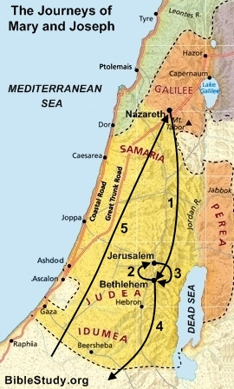
Nazareth in Galilee to Bethlehem in Judea (Luke) – as a result of the census called by the Roman Emperor.
Jesus is born while in Bethlehem
Bethlehem to Jerusalem (Luke) – for presentation in the temple, according to Jewish custom
Jerusalem back to Bethlehem (Matthew)–Joseph learns that Herod is trying to kill Jesus, and that he should flee to Egypt.
Bethlehem to Egypt (Matthew) - the Holy Family flees to Egypt
Egypt to Nazareth (Matthew) – after Herod dies, the angel once again appears to Joseph in a dream and tells him to return to Israel. But because Herod’s son was now ruling, Joseph feared him, and returned instead to Galilee rather than Judea.

