Slide 1
Jesus as a Moral Guide
Chapter 4

Slide 2
Beatitude?
The very heart of Jesus’ preaching and teaching …
Beatitude = ‘happy’
They ‘illustrate’ Jesus – they reveal his love for us
They require that we live moral lives so we can know our true happiness
Challenge our notion of ‘happiness’
Our hearts are restless, until they rest in you, O God. ~St. Augustine

Slide 3
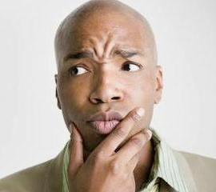
So, what is happiness?

Slide 4
Happiness is …
A state of pleasure or cheer
Temporary
Short-term
Comes and goes
Situational
Subjective

Slide 5
But beatitude happiness is different …
Being at peace yourself … your environment … your life
Even though you may not always be ‘happy’!
Long-term
Non-situational
Objective

Slide 6
The philosophy of happiness
Hedonism (Gk.) hedonia = the opposite of suffering, the absence of pain
Purpose of life is to maximize happiness!
Happiness is a destination
Eudaimonism (Gk., combines ‘good’ & ‘spirit’) eudaimonia = the state of having a good indwelling spirit
Happiness is a journey
WHICH ‘HAPPY’ ARE YOU ????

Slide 7
Jesus the moral norm
Jesus is our ideal model for living upright lives
“Put on the Lord Jesus Christ” Rom 13:14
Jesus as ‘incarnate’ = God became man, the Word-made-flesh and dwelt among us.
And yet, he was truly man, like us in every respect …
… so, we can do this!!!!

Slide 8
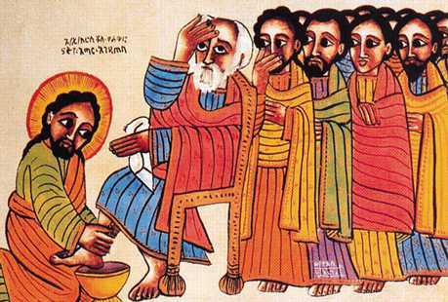
Jesus’ teaching
The Kingdom of God is at hand Mk 1:15
Repentance = turn away from sin, turn your life around!
Jesus’ tough love
Closing challenge at Mass ...

Slide 9
The Old Law …
The New Law
Old Law brought to fullness and completion in Jesus
Jesus emphasizes spirit and intent vs. letter-of-the-law
Old values >>> Beatitudes
Beatitudes = LOVE-IN-ACTION
Basis for Christian morality

Slide 10
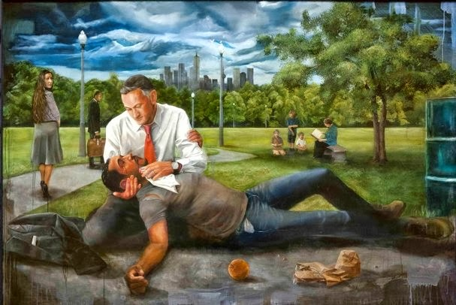
Love in Action …

Slide 11
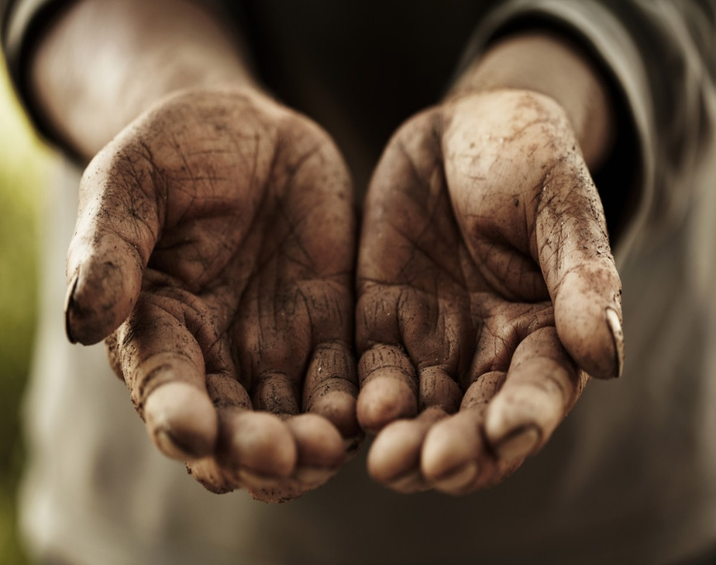
Humility …
In good works
Almsgiving
In prayer
Sincerely
Without empty words
In trust
Worrying wastes energy
Pre-occupation with self

Slide 12
The perfect prayer …
PRAISE:
Our Father, who art in heaven … hallowed by thy name … thy kingdom come, thy will be done, on earth as it is in heaven
PETITION:
Give us this day our daily bread and forgive us our trespasses, as we forgive those who have trespassed against us.
RECONCILIATION:
And lead us not into temptation, but deliver us from evil
PRAISE:
For thine is the kingdom, the power, and the glory, now and forever. Amen.

Slide 13
So, how do I live the Beatitudes (moral life)?
God gives us ‘grace’ from the Holy Spirit
Grace - God’s “favor, the free and undeserved help that God gives us to respond to his call to become children of God
Total gift - completely unearned
Given to us in baptism
Makes us a new creation in Christ
In that grace, God ‘justifies’ us
To ‘justify’ is to declare something right, good before God
You are declared good before God in your baptism, and thus ‘justified’ in the faith.
Our own ‘merit’
Our own efforts which lead us to ultimate happiness in union with God in heaven
Living a ‘holy’ life
To be Christ-like

Slide 14
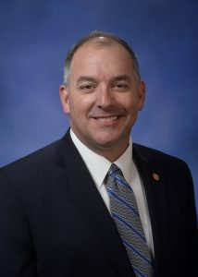
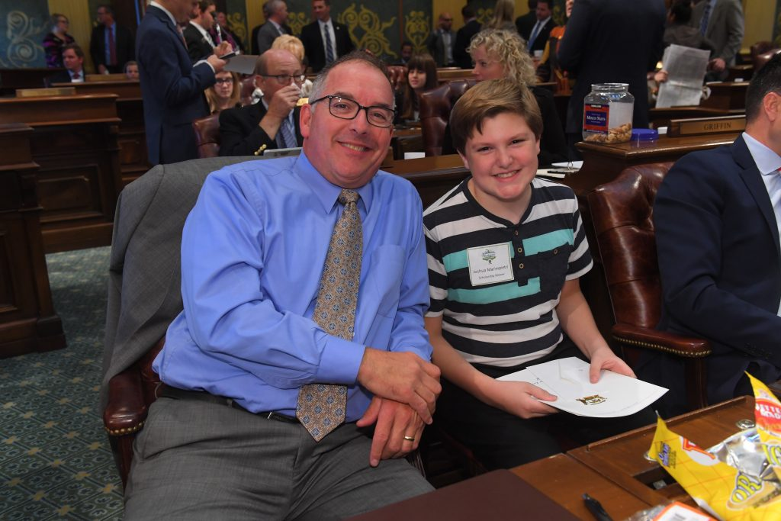
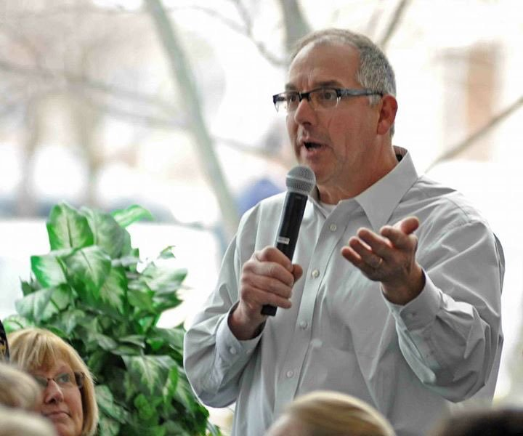
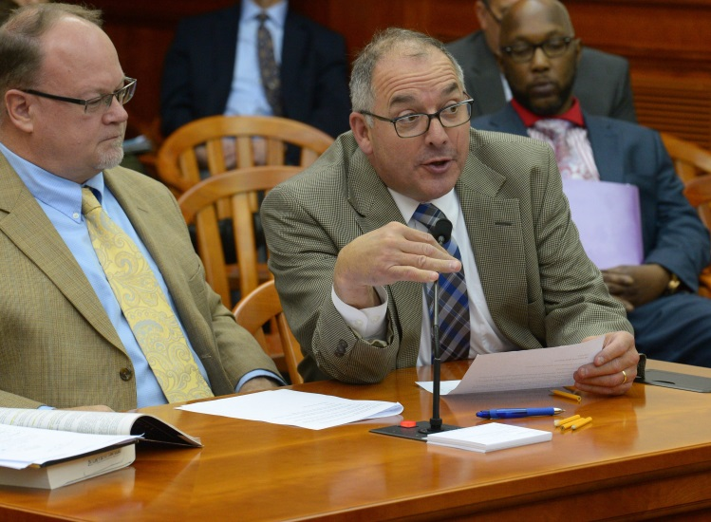
What of Mr. Bellino’s talk spoke to you personally?
What did Mr. Bellino’s talk mean to our discussion about living a Christian moral life?
What was your major take-away from this talk?

