Slide 1
CONSCIENCE
Chapter 5

Slide 2
Conscience
Defined:
the power of making a judgment between good and evil … doing the right thing
How do moral principles and values apply to a concrete situation?
What is the right thing for me to do?

Slide 3
What does the bible say?
And your ears shall hear a word behind you: “This is the way; walk in it,” when you would turn to the right or the left. Isaiah 30:21
Pray for us, for we are sure that we have a clear conscience, desiring to act honorably in all things. Hebrews 13:18
They (Gentiles) show that the demands of the law are written in their hearts, while their conscience also bears witness and their conflicting thoughts accuse or even defend them on the day when, according to my gospel, God will judge people’s hidden works through Christ Jesus. Romans 2:12-16

Slide 4
What does the Catechism say?
1778: Conscience is a judgment of reason whereby the human person recognizes the moral quality of a concrete act that he is going to perform, is in the process of performing, or has already completed. In all he says and does, man is obliged to follow faithfully what he knows to be just and right. It is by the judgment of his conscience that man perceives and recognizes the prescriptions of the divine law:
Conscience is a law of the mind; yet [Christians] would not grant that it is nothing more; I mean that it was not a dictate, nor conveyed the notion of responsibility, of duty, of a threat and a promise. . . . [Conscience] is a messenger of him, who, both in nature and in grace, speaks to us behind a veil, and teaches and rules us by his representatives. Conscience is the aboriginal Vicar of Christ.
John Cardinal Newman

Slide 5
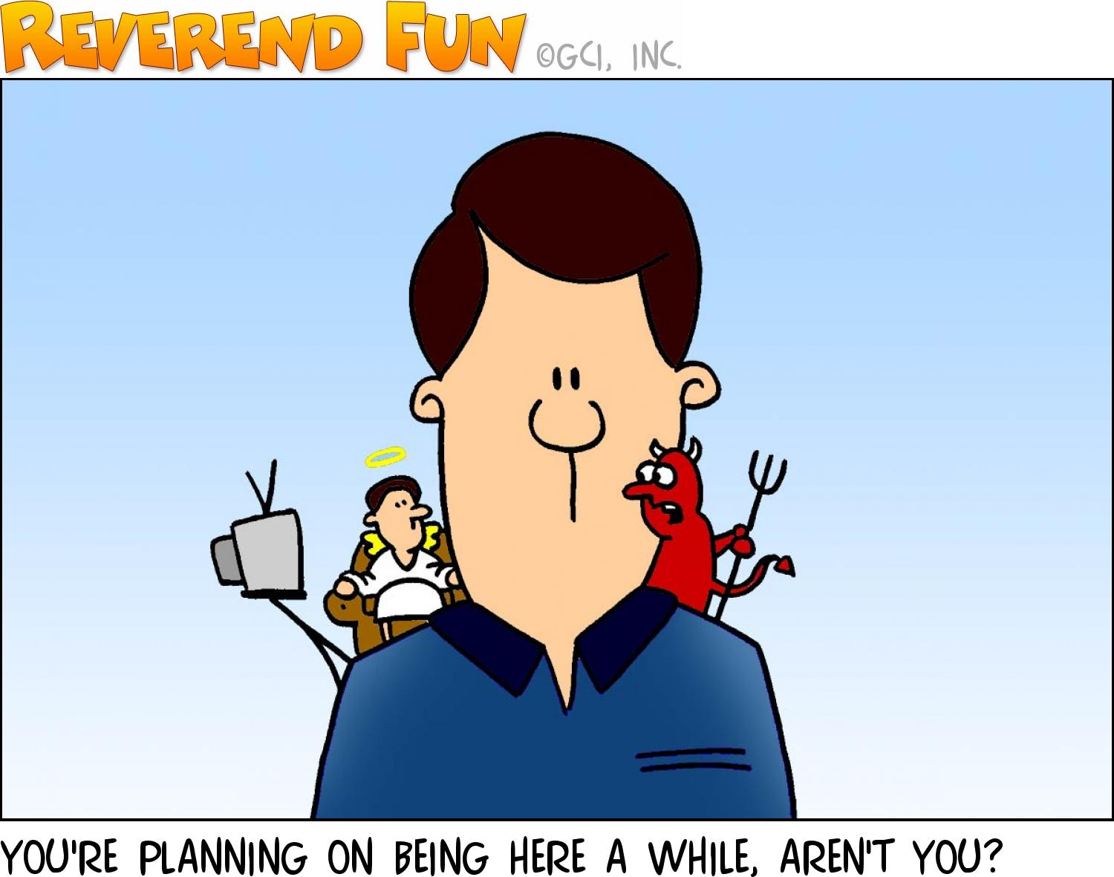
The right thing depends upon …
Knowledge
Evaluation
Application

Slide 6
Knowledge …
Need to know first what ‘right’ is … what it looks like
Need to know and understand the ‘rules’ and boundaries
Learned behavior

Slide 7
Evaluation …
Size up your situation
Prioritize what’s important

Slide 8
Application …
Matching our moral principles and values to our individual circumstances
Notes:
Because our principles and values are so different, and because our circumstances are our circumstances, we can’t avoid making very personal judgments of conscience.
So the work of discernment is very personal.

Slide 9
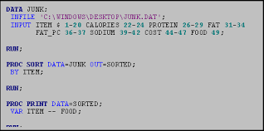
Following my conscience …
Our conscience is the FINAL NORM for judging the morality of our action
We must follow our conscience even when it’s wrong

Slide 10
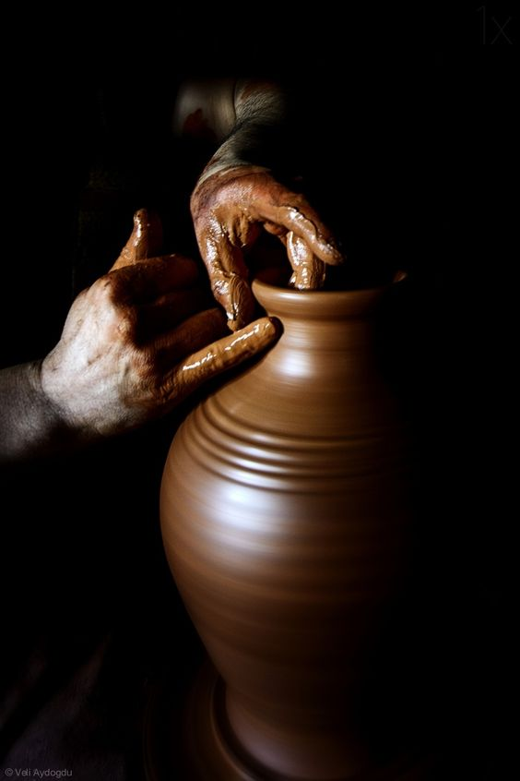
Forming my conscience …
Has to be learned, formed through experience
Faith ‘informs’ our conscience, just as other inputs do …
Worship
Bible
Prayer

Slide 11
The bottom line …
Wrong harms … good gives life to us and others
Ignorance of right and wrong might free us from fault, but we and others could still be harmed
The importance of forming our conscience properly cannot be understated!

Slide 12
Putting my conscience into practice
Acting on our conscience is as important as forming our conscience
The virtue of PRUDENCE is critical to acting and forming
Right reason in action (Aquinas)
The challenge: aligning principles and circumstances
Whatever decision I make .. I own it
If it’s the wrong decision, conscience will let me know!

Slide 13
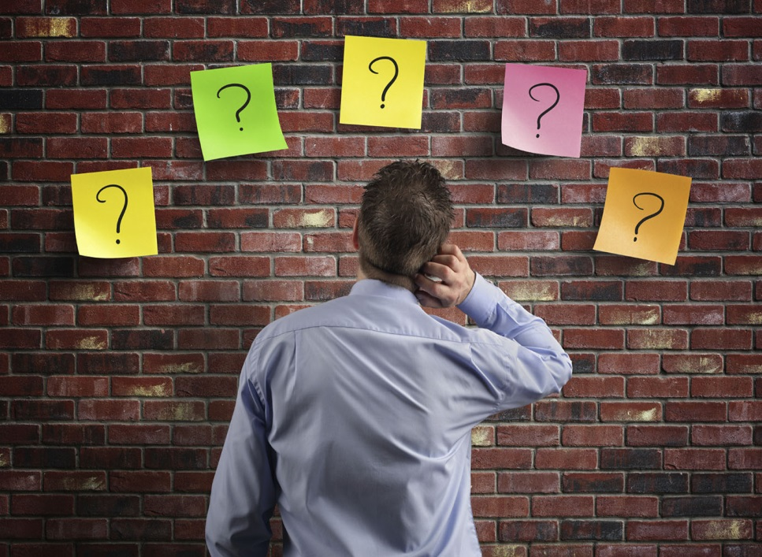
Prudence ….
Right reason in action (Aquinas)
Governs other virtues
Sets rules and boundaries
Correct judgement
Helps form conscience
Is necessary for correct judgement

Slide 14
Freedom of conscience …
My conscience is my conscience – no one else may impose judgment on my conscience
No civil government has the right to tell me what I must believe or what religion to practice

Slide 15
Reflection
Where did you see conscience at work in the Union officer? Explain.
Where did you see conscience at work in the Confederate spy? Explain.
How did the role of conscience determine the outcome of this story? Explain.

Slide 16
Blessed are the poor in spirit, for theirs is the kingdom of heaven
Blessed are they who mourn, for they will be comforted.
Blessed are the meek, for they will inherit the land
Blessed are they who hunger and thirst for righteousness for they will be satisfied
Blessed are the merciful, for they will be shown mercy
Blessed are the clean (pure) of heart, for they will see God
Blessed are the peacemakers, for they will be called children of God
Blessed are those who are persecuted for the sake of righteousness for theirs in the kingdom of heaven

