Slide 1
Sin and Forgiveness
Chapter Six

Slide 2
What is sin?
A deliberate offense against God … the rejection of good
Any thought, word, or deed that deliberately disobeys God’s will and in some way rejects God’s divine goodness and love
Sin in turn creates the tendency to sin, by the repetition of same acts (CCC 1865)
Notes:
Break down the words:
Thought, word, deed … or all three
Deliberately disobeys God’s will
God’s will
Rejects God’s divine goodness and love

Slide 3
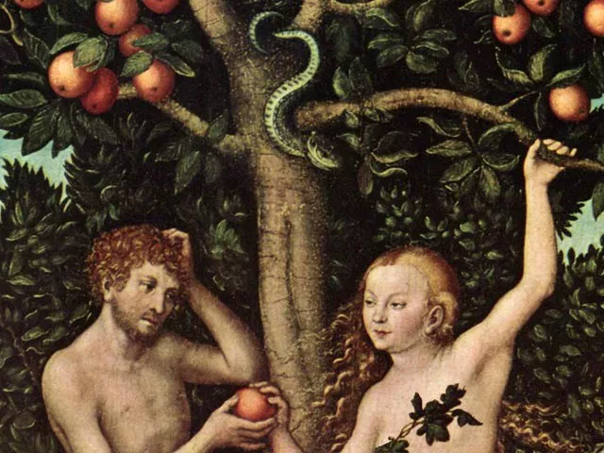
Where did sin come from?
Now the snake was the most cunning* of all the wild animals that the LORD God had made.
Now the snake was the most cunning of all the wild animals that the LORD God had made. Genesis 3:1

Slide 4
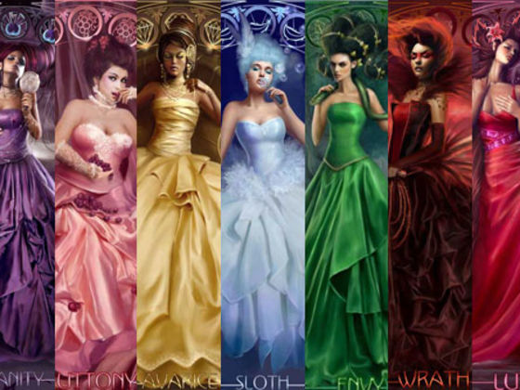
Seven Deadly Sins
Lust
Greed
Gluttony
Envy
Anger
Pride
Sloth

Slide 5
Origins of the Seven Deadly Sins
Do not appear in the bible in list form, but are based on biblical concepts
Another meaning in the Church:
Cardinal vices
Cardinal sins
Greek monastic theologian Evagrius of Pontus
Pope Gregory the Great
Dante: Divine Comedy (Inferno)
Notes:
They do not appear in list form in the Bible, but they are biblical concepts, e.g
“But I tell you that anyone who looks at a woman lustfully has already committed adultery with her in his heart” (Matthew 5:28)
“ … anyone was unwilling to work, neither should that one eat.^{” 2 Thes 3:10}
Greek monastic theologian Evagrius of Pontus, 4th century monk … traveled to the desert to be alone and pray … meditated on sin. Came up with 8 grave sins …
Pope Gregory the Great later in 6th century narrowed them to 7 and called them ‘deadly’ …
Dante – 12th century Italian poet … wrote a literary piece based on the Seven Deadly Sins … and it’s about a trip through the afterlife .. Has 3 parts … inferno (hell), purgatory and paradise ..
Proposes virtues to battle these sins

Slide 6
Seven Capital Sins
ORIGINAL
EQUATES TO
Lust
Greed
Gluttony
Envy
Anger
Pride
Sloth
Sexual actions
Want of everything, yours or not
Over-indulging, ignorance
Jealously towards others
Lack of control
Arrogance
Laziness

Slide 7
Sin survey …
 | 1H | 2H | 3H | 5H
1
2
3

Slide 8
Sins and Virtues …
SIN
VIRTUE
Lust
Greed
Gluttony
Envy
Anger
Pride
Sloth
Chastity
Charity
Temperance
(self-control)
Kindness
Patience
Humility
Diligence
Notes:
What’s a virtue? A habit of good behavior that enables us to do what is right with ease, pleasure and consistency.
It’s the opposite of sin …
It’s the remedy for sin …
Sin leads us away from God …
Virtue leads us toward God …
E.g. Patience is a virtue – long line at Meijer … how will I view that?
What the Church teaches about virtues?

Slide 9
The affect of sin …
Alienates us from God …
Alienates us from ourselves …
Alienates us from others …

Slide 10
What does the BIBLE say about sin?

Slide 11
Old Testament
Sin came from Adam & Eve’s disobedience
Three themes in the Old Testament:
Hattah: ‘Missing the mark’
Pesha: Rebellious
Awon: Guilt, iniquity
The consequences of sin = alienation from God, ourselves, others

Slide 12
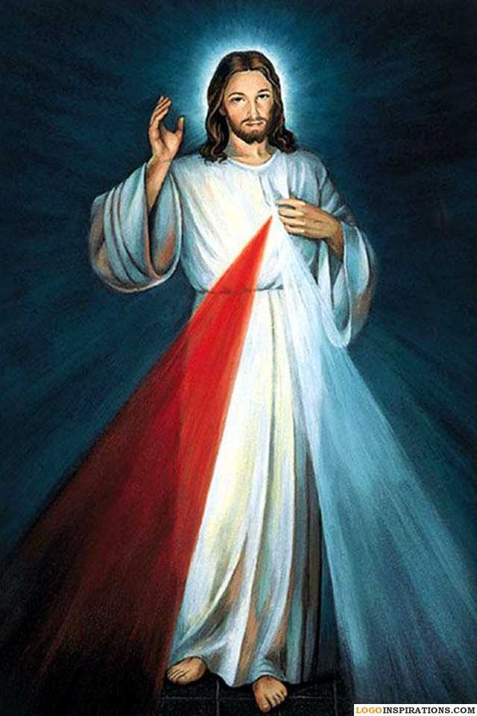
New Testament
This is the time of fulfillment. The kingdom of God is at hand. Repent, and believe in the Gospel. (Mk 1:15)
Jesus’ response to sin: Mercy and Forgiveness
Jesus – the Divine Physician

Slide 13
What does the CHURCH say about sin?

Slide 14
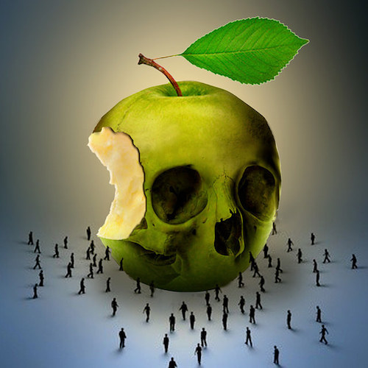
Types of sin …
Original vs. Personal
Mortal vs. Venial
Social

Slide 15
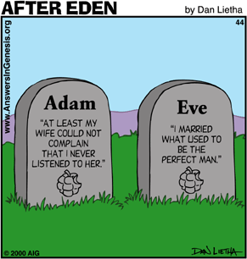
Personal sin …
It all started with a bad decision …
Personal – it’s mine … I own it
Concupiscence: inclination to evil and temptation to commit personal sin

Slide 16
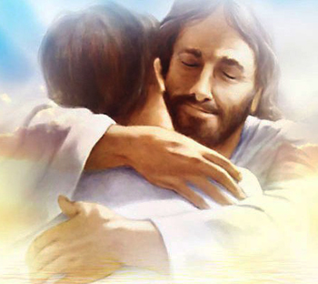
Categories of sin …
Mortal
Venial

Slide 17
Types of Sin: Mortal
A “grave violation of God’s law”
Destroys charity (love) in us
Three things must be present:
The object of the sin must be a grave matter (Ten Commandments)
Full knowledge of the gravity of the sin
Deliberate act – full consent

Slide 18
Effects of mortal sin …
Loss of sanctifying grace
Loss of God’s friendship
Loss of heaven
Remedy: RECONCILIATION

Slide 19
Types of Sin: Venial
Venial = ‘easily forgivable’
Less serious (grave) matters
Weakens , doesn’t destroy charity (our focus on the needs of others)
Suggests a disordered affection for things that lead us away from God
Encourage to practice humility to restore our balance

Slide 20
Types of Sin: Social
Still a ‘personal’ sin
A ‘cycle’ of sin caused by individual (personal) sin
When we participate in another’s sin
Widens the circle of sin

Slide 22
What is the remedy for sin?
Two-steps to growing in holiness:
Admitting we’re not perfect
Repentance for our sins and our openness to conversion

Slide 23
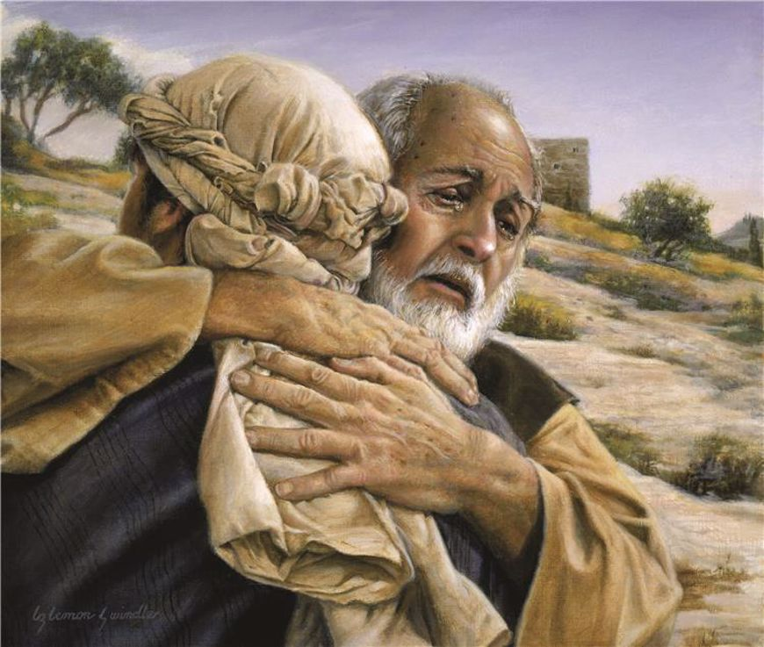
Sin & Forgiveness

Slide 24
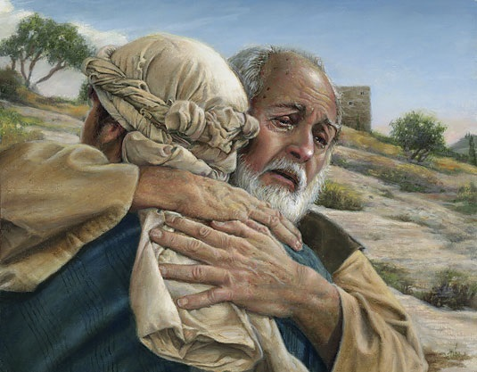
Endless mercy of God …
Prodigal Son – God comes ‘off the porch’ to forgive us
The only unforgiveable sin:
Deliberate refusal to accept God’s mercy through repentance
Total reject of God’s forgiveness and salvation offered through the Holy Spirit

Slide 25
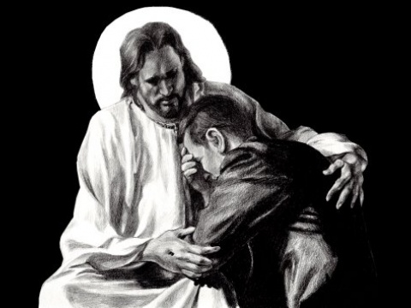
Reconciliation …
Scriptural: both Old and New Testaments
John 20:21-23
A sacrament celebrating God’s reconciling love

Slide 26
The names of forgiveness …
Reconciliation: A sacrament celebrating God’s reconciling love
Penance: our openness to conversion
Conversion: to change … a life-long process!
Starts with our contrition for sins = true sorrow
Confession: the actual confessing of our sins
Absolution: the grace of forgiveness offered by God in persona Christi
Sin alienates – Reconciliation restores!

