Slide 1
Love for God
Chapter 7

Slide 2
Where we’ve been …
CH-1 – Who are you?
CH-2 – Making good and moral decisions – S.T.O.P. model
CH-3 – How law, freedom, and free-will impact decision making
CH-4 – Jesus and his Beatitudes as the moral norm
CH-5 – The power of our conscience in living good and moral lives
CH-6 – The power of sin and temptation in our lives, weighed against God’s endless mercy and compassion
CH-7 – LOVE – the OTHER SIDE OF SIN – Ten Commandments

Slide 3
Stump the student ….

Slide 4
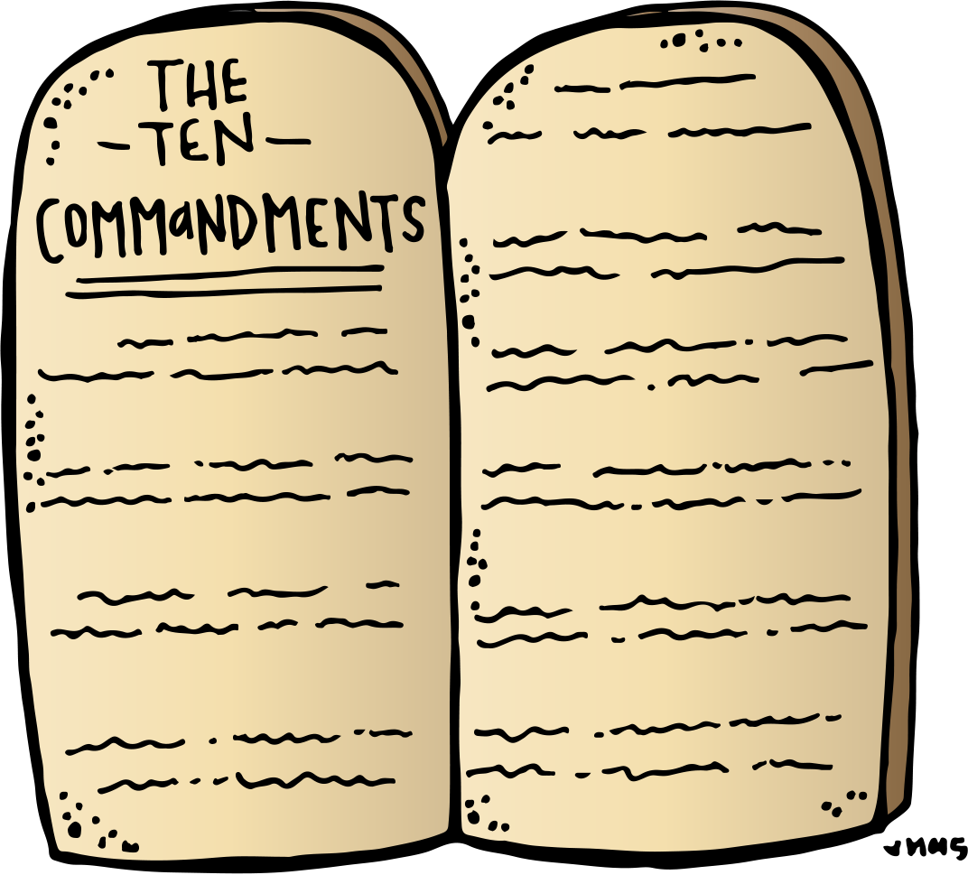
The Ten Commandments

Slide 5
The Ten Commandments
I am the LORD your God. You shall not have strange gods before me.
You shall not take the name of the Lord your God in vain.
Remember to keep holy the Lord’s day.
Honor your father and your mother.
You shall not kill.
You shall not commit adultery.
You shall not steal.
You shall not bear false witness against your neighbor.
You shall not covet your neighbor’s wife.
You shall not covet your neighbor’s goods.

Slide 6
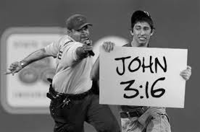
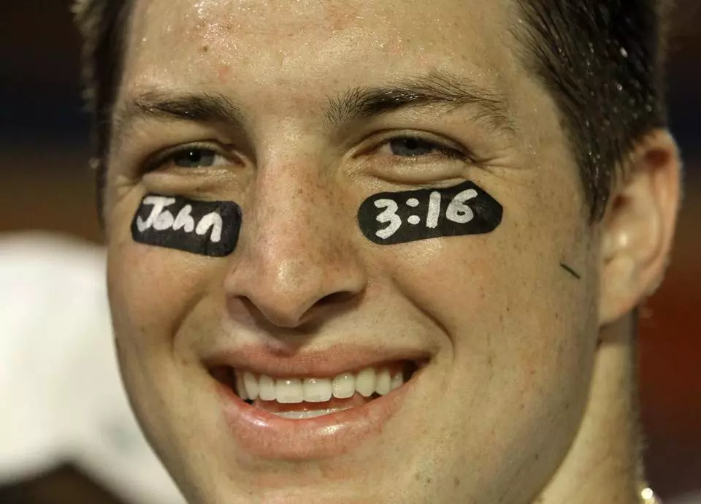
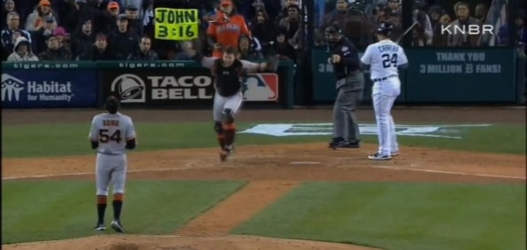

Slide 7
Theological Virtues
Faith
Hope
Love
Virtues related directly to God
Gifts God gives us to lead a moral life
Infused into our souls

Slide 8
THE MOTHER OF ALL VIRTUES
~St. Thomas Aquinas
Agape (‘Daddy’) love = God’s very nature is love, the very source of this virtue
We love because he first loved us. 1 John 4:19
If God so loved us ..we must love one another
Love is how we ‘see’ God = sacrament
Love is the command of Jesus – Mt 22:34-40

Slide 9
CHARITY INVOLVES:
Obedience – Obeying Jesus’ commands
Reverence – Respecting and valuing goodness of God and others
Sacrifice – Commitment on our part, never giving up on God or others

Slide 10
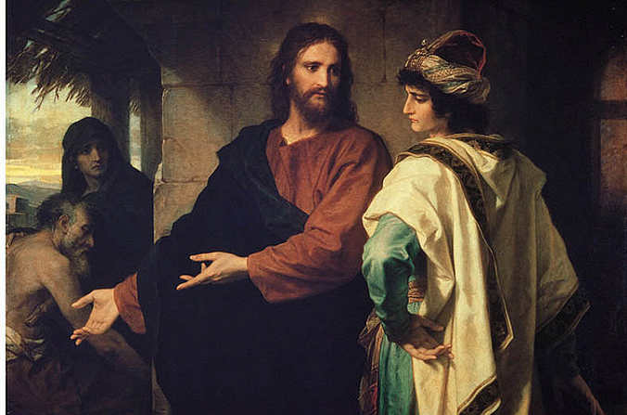
Keeping the Commandments

Slide 11
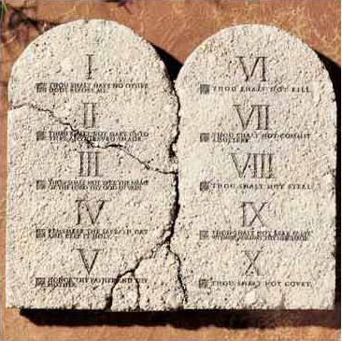
Decalogue …
“TEN WORDS”
Exodus
Deuteronomy

Slide 12
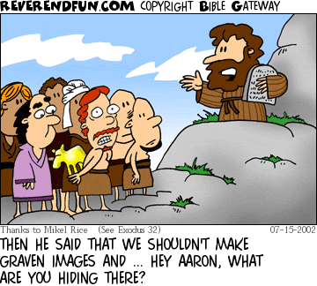
First Commandment …
You shall worship the Lord your God and Him only shall you serve

Slide 13
First Commandment …
FAITH: Saying ‘yes’ to God
Abraham
Mary
We strengthen our faith by:
Prayer – our best friend
Reading bible – our family history
Sacraments
Study
Role models
FAITH IN ACTION!
Temptations that threaten faith:
Voluntary doubt
Incredulity
Heresy
Apostasy
Schism

Slide 14
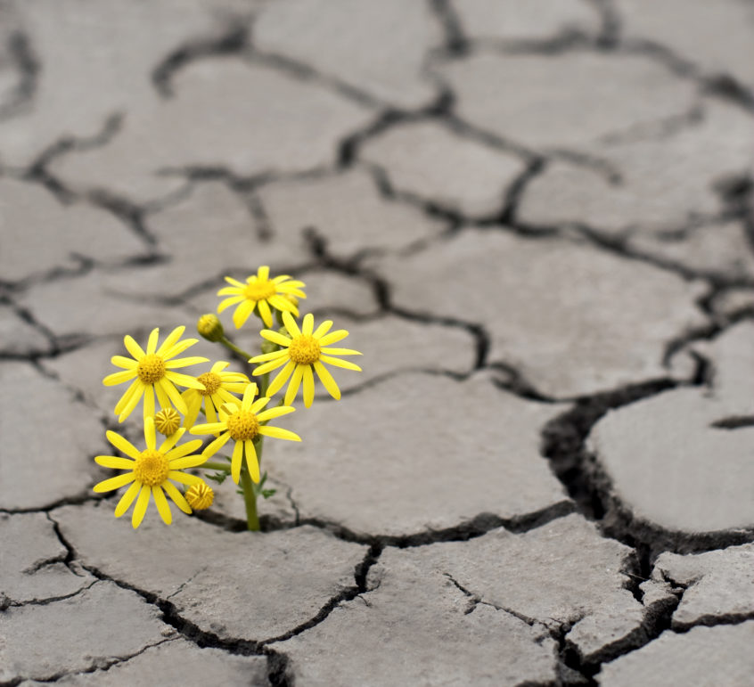
First Commandment …
HOPE: Trusting that God ‘has this’
What do you hope for?
Examples: Mary, St. Monica
Violations: Despair, presumption
We strengthen our faith by:
Prayer – our best friend
Reading bible –family history
Sacraments
Study
Role models
FAITH IN ACTION!

Slide 15
First Commandment …
LOVE: Agape – holding someone close to your heart

Slide 16
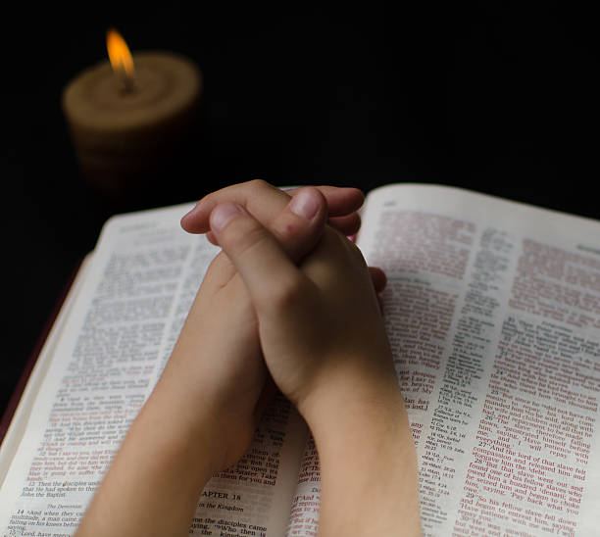
Living the First Commandment …
Faith ≠ Religion
Faith – Hebrews 11:1
Religion – how we act it out
How we worship God:
Adoration
Prayer
Sacrifice
Vows

Slide 17
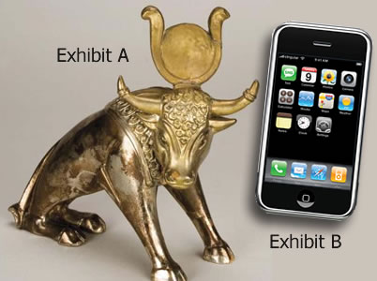
Offenses to the First Commandment …
What else do we make our ‘god’?
Idolatry
Polytheism
Superstitions
Divination
Magic, Spiritism
Irreligion, sacrilege
Atheism v. Agnosticism
Humanism v. materialism

Slide 18
Second Commandment …
You shall not take the name of
the Lord your God in vain

Slide 19
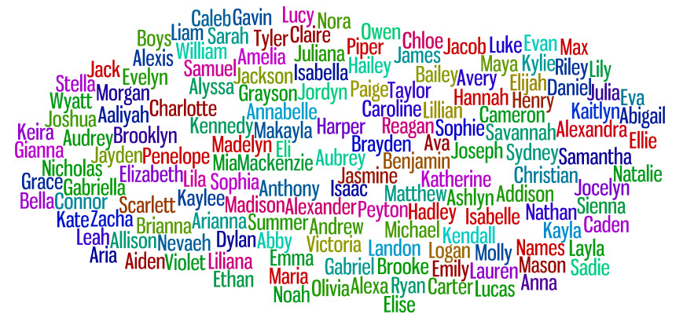
Second Commandment …
We are called by name …

Slide 20
Your NAME …
What does your name mean? First, middle, Confirmation?
Where does it come from? Do you know how you got that name?
What are some characteristics of that name, and how does your personality align to that?
What do the names of your parents mean, and does it speak anything about you?

Slide 21
What is God’s name?
I AM who I am …
Yahweh = Hayah = ‘existed’
Present = I am
Future = I will be
… is now and ever shall be … world without end, Amen.

Slide 22
“Christian” ….
Jesus … ?????
‘I baptize you in the NAME of the Father, the Son, and the Holy Spirit …”
Confirmation NAME

Slide 23
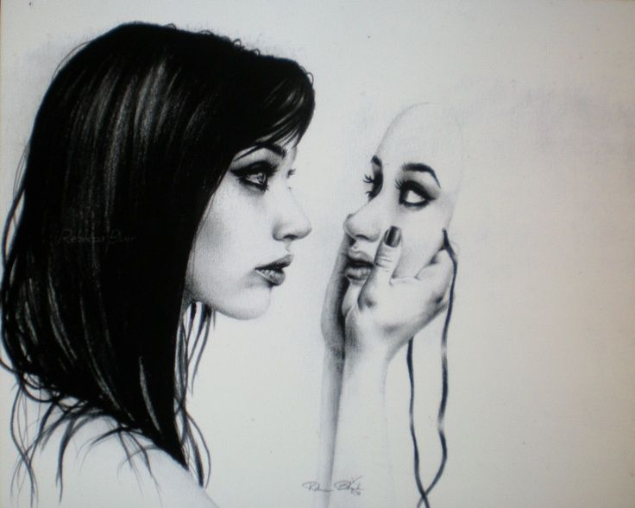
Second Commandment Offenses …
Dishonors God, others, us
Offenses against God’s name:
Breaking promises
Blasphemy
Swearing

Slide 24
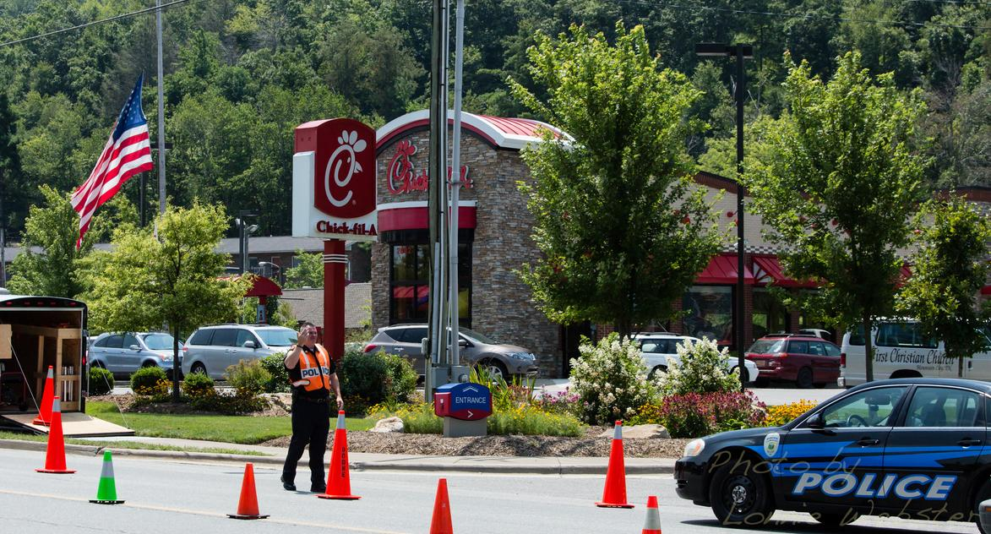
Third Commandment …
Remember to keep holy the Lord’s day
ENCOURAGES THE VALUE OF:
REST
PLAY
PRAYER

Slide 25
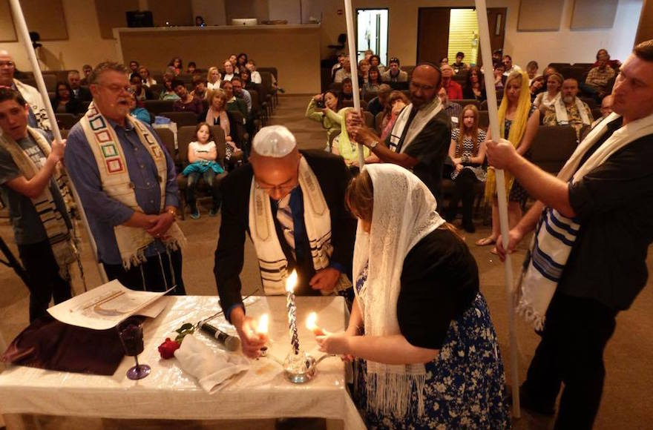
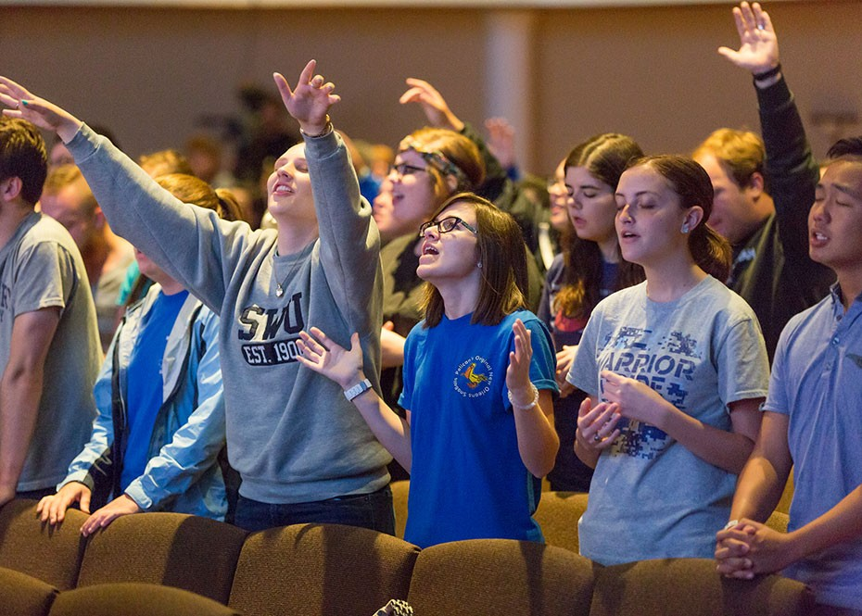
Sabbath Day …
JEWS
Saturday
CHRISTIANS
Sunday

Slide 26
Make a family crest …

Slide 27
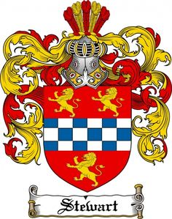
Family crest …
Using the meaning of names as you find them, first determine your family theme.
The theme should be at the center of your crest, illustrated in some way by a symbol you choose to make that theme clear (e.g. ‘Strength of God’ could have a cross with a crest of armor).
Then, the themes of each individual name (your first, middle, Confirmation, Dad’s first, Mom’s first) should surround the main theme symbol.
Finish the crest in some decorative way.
Use your imagination!

