Slide 1
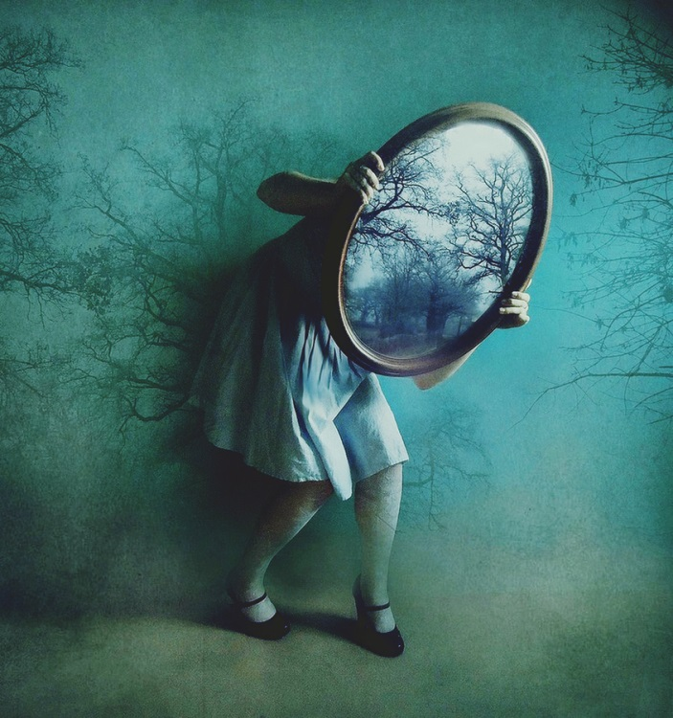
RESPECT FOR LIFE
Chapter 8

Slide 2
Healthy Self Love
We should love ourselves because …
we are made in God’s image & likeness
we are loved by Jesus Christ, who forgives our sins and died for us on the cross
we have inherent dignity!
your value in God’s eyes does not come from anything you’ve done or not done .. It is unconditional

Slide 3
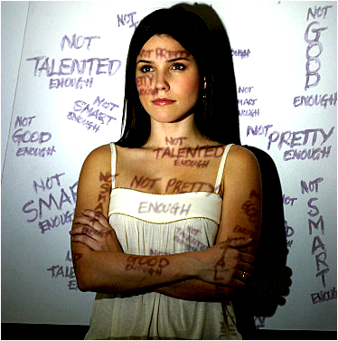
So what’s the problem?
Why can’t so many of us love ourselves as God loves us?
Because we listen to voices other than God
Voices that don’t know who we are on the inside

Slide 4
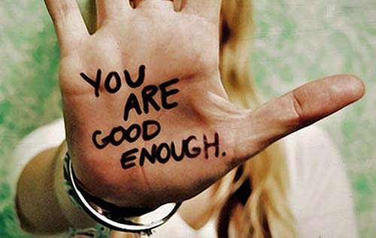
The virtue of self-esteem
‘Esteem’ (Lt.) = value – how we value ourselves
Self-esteem is a virtue (a ‘habit of good’)
We are challenged to accept ourselves as God accepts us - apart from achievements, talents, the opinions of others
Who is your ideal
model of this
virtue?

Slide 5
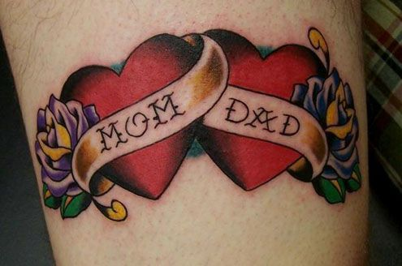
The Fourth Commandment
Honor your father and mother
Self-love begins with knowing where we came from
Care for aging parents varies by culture
Ageism – age discrimination
Euthanasia – assisted suicide

Slide 6
Importance of family values …
The family is the society’s foundational unit.
Family:
Love between parents
Procreation
Pass on the faith
Catholic understanding:
‘The Domestic Church’
Religious liberty

Slide 7
Religious liberty …
Definition of ‘family’
The fundamental right of life
The right to express faith freely
Basic human rights:
Employment
Housing
Nutrition
Health Care
Education

Slide 8
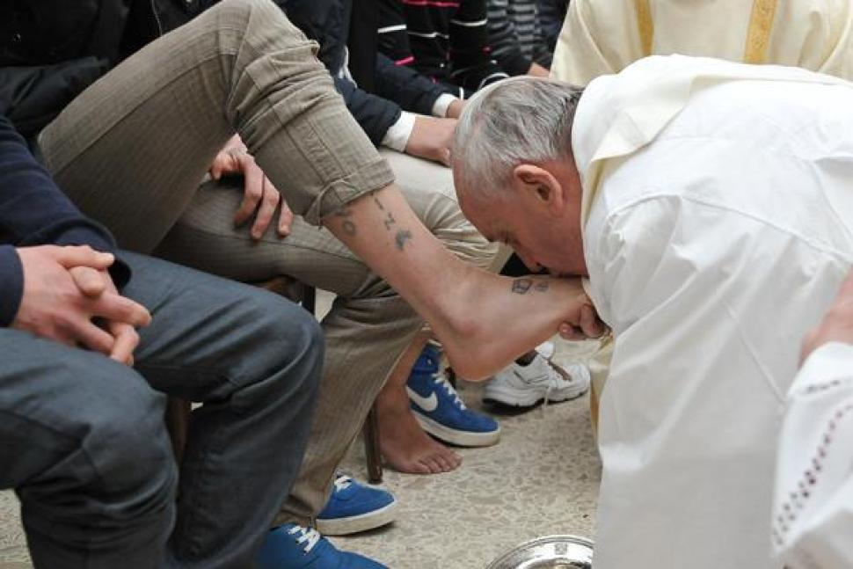
To honor …
Esteem, value, privilege, respect, admiration,
Recognition of another’s dignity
Honor structures by role, title (parent, adult, child, military, law enforcement, etc.
Honor goes two-ways – it must be both given and returned

Slide 9
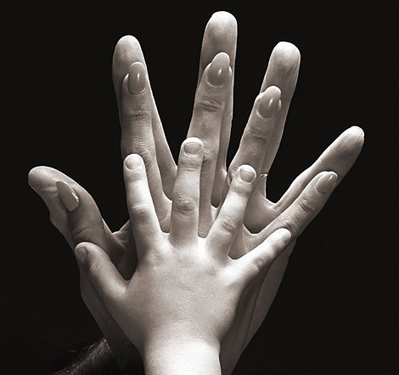
Honoring parents …
Greatest relationship of honor
First teachers
Honor is a two-way street – parents responsible for honoring their children
Church extends this honor to the ‘spiritual’ family

Slide 10
Faithful citizenship …
Responsible citizenship is a virtue
Parents teach and model for their children
U.S. Bishops – ‘A community of conscience’

Slide 11
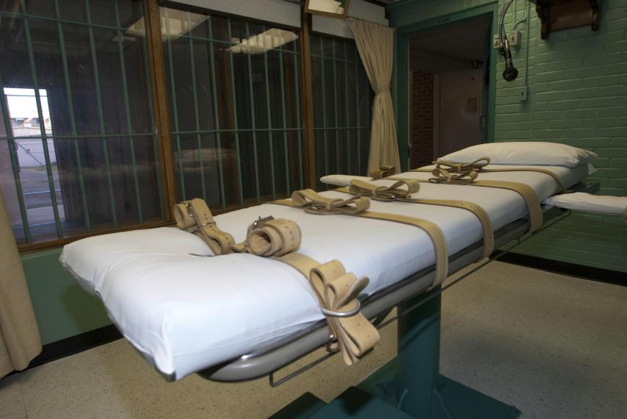
Capital Punishment … what’s the purpose?
To set right the disorder caused by criminal offenses
To preserve public order and personal safety
To correct the offender
What does Jesus have to say? Matthew 5:38-48

Slide 12
Capital Punishment … is it worth it?
Nearly 2M people in U.S. criminal justice system
40,000+ inmates, $47K annual cost per inmate
$2.0 billion annually
Capital punishment in 30 states - not Michigan
Higher economic cost of capital punishment due to appeals
Cost of lethal drugs is less than $100
Lethal injection death in average of 7 minutes

Slide 13
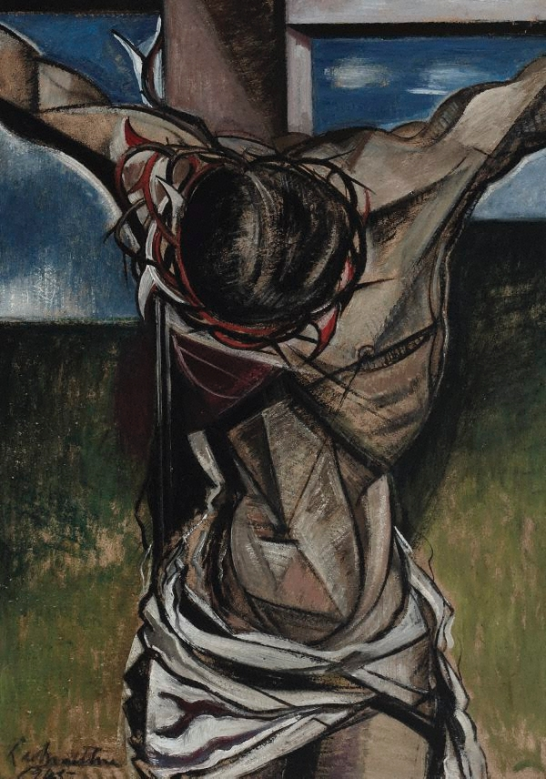
Bishops oppose capital punishment …
Not necessary to protect society
Violates respect for human dignity
Diminishes all of us
Deeply flawed, irreversibly wrong, prone to errors
Biased by outside factors (e.g. race)
Other ways to punish criminals, protect society

Slide 14
Abortion …
Deliberate killing of unborn human life by means of medical or surgical procedures
A grave and unjustified attack on innocent human life
It is human life … from the moment of conception
All human life is sacred
Made in God’s image
Possessing worth and dignity
A violation of natural law

Slide 15
Abortion statistics …
YEAR: | NUMBER:
2014 | 652,639
2013 | 644,435
2012 | 699,202
2011 | 730,322
2010 | 765,651
2009 | 784,507
2008 | 825,564
2007 | 827,609
2006 | 846,181
2005 | 820,151
2000 | 857,475
1980 | 1,297,606
2014 AT A GLANCE …
ABORATION RATE: 12.1 abortions per 1,000 women aged 15–44 years
ABORATION RATIO: 186 abortions per 1,000 live births
Women in their 20’s account for most abortions
91.5% occurred <13 wks gestation
1.3% occurred >21 wks
22.6% were medical abortions (non-surgical, usually oral medications)

Slide 16
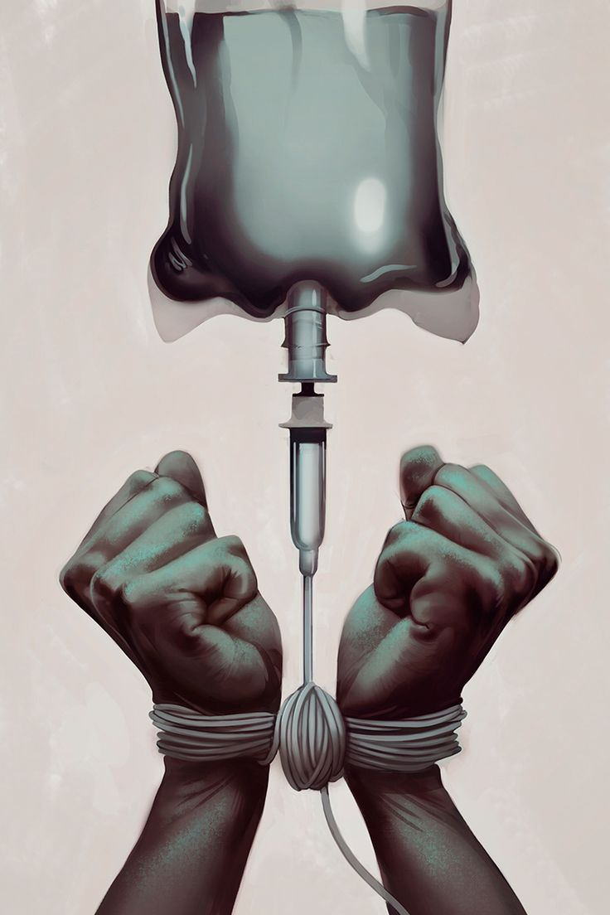
Euthanasia …
Allowing one who is suffering from incurable illness to die by painless measures, by withholding ‘aggressive medical treatment’
When natural death is imminent
Ordinary means of care must be used on those who are not in process of natural death
Extraordinary means of care

Slide 17
Factors increasing the risk of suicide …
Psychological disorder, esp. depression
Substance abuse
Feelings of hopelessness or worthlessness
Previous suicide attempt
Family history of mental illness or suicide
Emotional, physical, sexual abuse
Lack of a support network
Poor relationship with parents or peers
Social isolation
Struggling with sexual identity
Perfectionism

Slide 18
Warning signs of suicide
Talking about suicide or death in general
Hinting about ‘not being around anymore’
Talking about feeling hopeless or guilty
Pulling away from friends, family
Writing songs, poems, letters about death, loss, darkness
Giving away treasured possessions
Losing the desire to do favorite things
Trouble concentrating or thinking clearly
Changed eating or sleeping habits
Engaging in risky or self-destructive behaviors
Losing interest in school or extra-curricular activities

