Slide 1
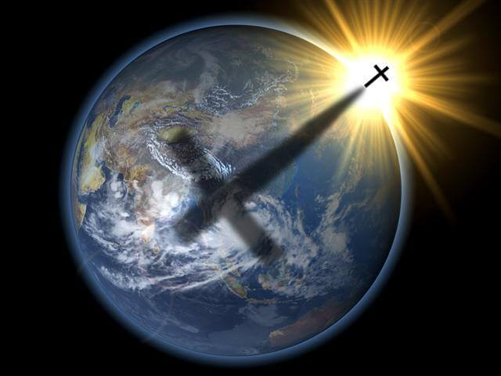
CHAPTER 1
God’s Good Creation: The Beginning of Salvation History

Slide 2
But why?
Why doesn’t glue stick to the inside of the bottle?
Why is the word ‘abbreviation’ so long?
Why don’t sheep shrink when it rains?
Why isn’t ‘phonetic’ spelled the way it sounds?
Why do we park on driveways and drive on parkways?
Why are there flotation devices under airplane seats instead of parachutes?
Why is the third hand on a watch called a second hand?
Why is the time of the day with the slowest traffic called ‘rush hour’?
Why do ‘fat chance’ and ‘slim chance’ mean the same thing?
Why isn’t there mouse-flavored cat food?
Why do they report power outages on TV?

Slide 3
Philosophical Questions of Life
What is the meaning of life?
Why am I here?
Why me, and not someone else? Why was I born here, in a land of plenty, while others are starving in other nations, right this minute.
Where am I going after this?
How best to live my life in order to get where I’m going?

Slide 4
Philosophy
The investigation of truth and principles of human reason

Slide 5
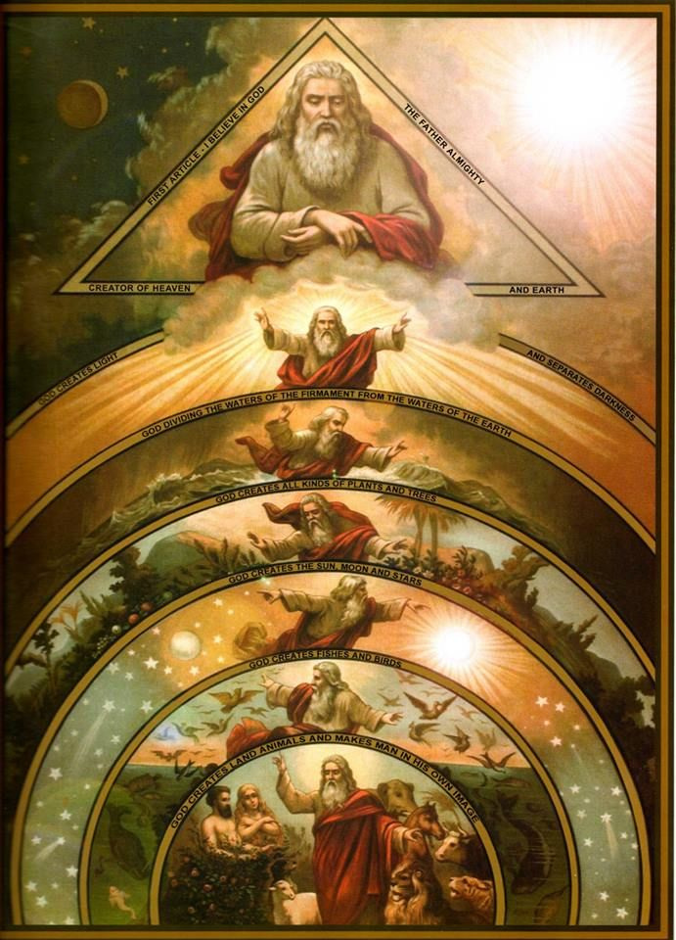
What does theology mean?
‘OLOGY’ =
Study of …
Biology
Psychology
THEOS’ =
GOD

Slide 6
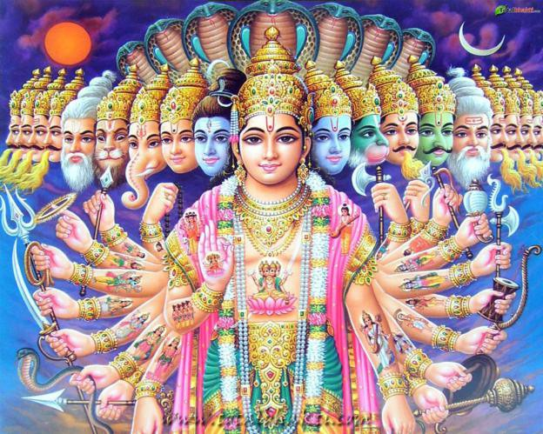
Theories of God and origins of the universe
Pantheism = the religious belief that the material world and the creator of the world are one in the same.
Monotheism = believe that there is only one god responsible for the creation of the universe.
Polytheism = many gods
Christianity?????

Slide 7
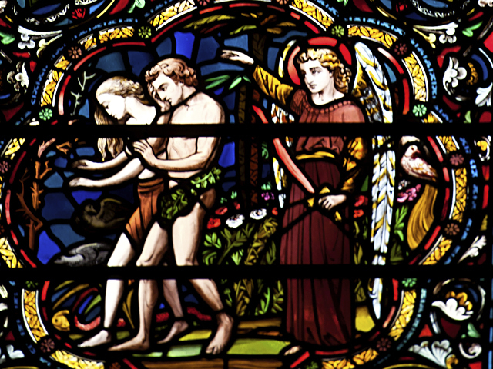
Salvation History
The story of God’s saving actions on our behalf

Slide 8
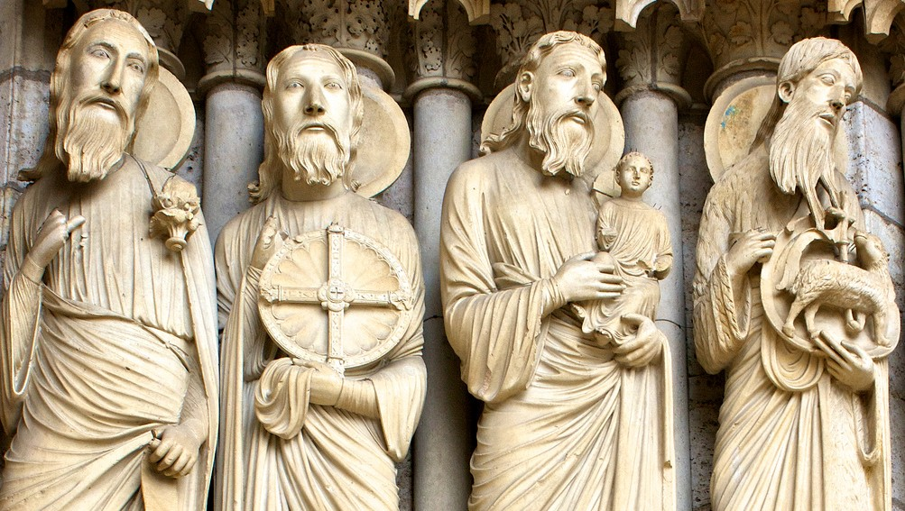
Figures in Salvation History
Patriarch – A father in faith
Abraham, Moses, Aaron, Isaac, Jacob, etc.
Prophet – One chosen to speak for God
Isaiah, Jeremiah, Ezekiel

Slide 9
Divine Revelation
God’s free gift of self-communication by which he makes known the mystery of God’s divine plan.
Deposit of Faith – Holds Divine Revelation for all generations. Contains two elements:
Sacred Scripture – Old and New Testaments. God’s sacred word, divinely inspired, through human authors.
Sacred Tradition – the oral testimony of the Church handed down through generations.

Slide 10
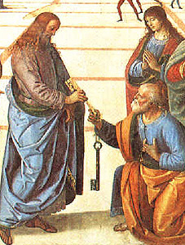
Magisterium
Keeper of the Deposit of Faith
Authoritative interpretation and teaching of God’s Word in Sacred Scripture
Guided by the Holy Spirit
Notes:
Keeps the Church free from error
Refer back to the Gospel from yesterday … Jesus handed over authority to Peter … this is part of that authority.

Slide 11
Bible
A library of books organized into different sections by time period, and by literary form
Deals with people of various times, cultures, places

Slide 12
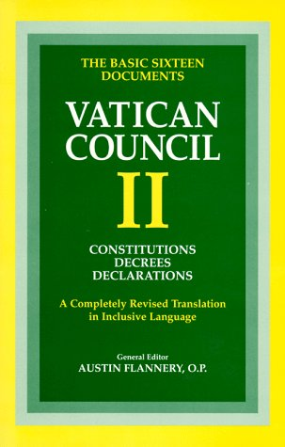
Interpreting Scripture
Second Vatican Council: “Sacred Scripture must be read in light of the same Spirit by whom it was written”
Using two main senses:
Literal: Exegesis
Spiritual
Notes:
Second Vatican Council: at that time, Catholics were not involved in the Word in Mass … so this was meant to encourage them to begin taking an active part.
TWO MAIN SENSES:
1. Literal: What we actually see, experience, feel. What’s your reaction when Jesus calls us his “sheep”?
Read yesterday’s Gospel … Mt 16:19
How do we do that? Exegesis (Gk. “to lead out” to break open) … trying to determine what the writer LITERALLY meant to convey to us.
There’s many different forms we see at work when we do that. DEBATE in the Book of Job. PARABLE in both the Old and New Testaments. Tells a story with a surprise ending … to make us think.
2. Spiritual: Not just looking at the words, but what they might mean … what was God trying to convey to us? Example: Allegory, e.g. Creation story (what was God trying to say to us?)
Also depends on what’s going on in your life right now. E.g. friend going through divorce … serious illness, Mt 11:28.

Slide 13
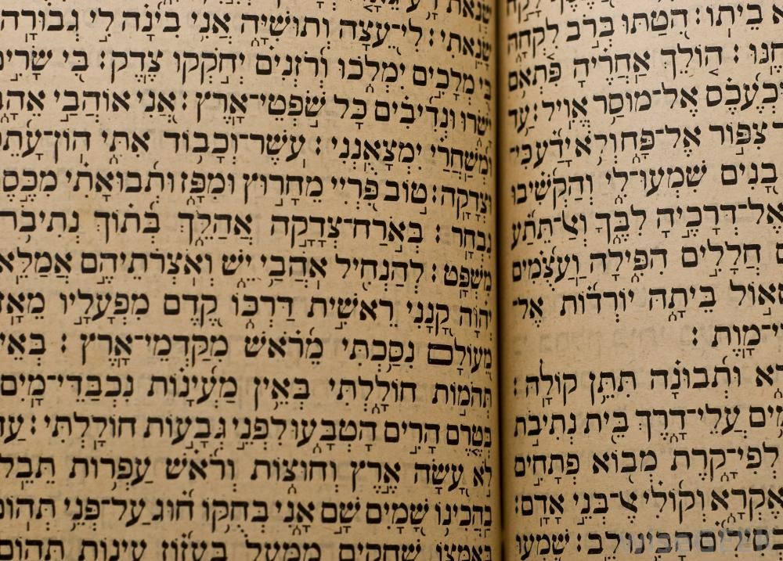
Interpreting Scripture
Requires understanding of:
What circumstances was it written in? (e.g. time, people, culture)
What literary form is it? (e.g. historical, prophetic, poetic, allegory, parable, etc.)
What is God trying to teach us by use of this literary form?
Notes:
Circumstances … the customs, norms of the time: Much of the bible written in patriarchal society.
Literary Forms: Would we interpret a fable (emphasis on imagination) differently than a news story or an historical account (just the facts)?
READ EPHESIANS 5:21-24. Ladies – how does that make you feel? But it was the norm of that time, as it was even when I was young. Look at the balance of the letter.
READ ECCLESIASTES 3:1-4. What is the form?
READ MATTHEW 1:1-2. What is the form? [historical, genealogical
READ LUKE 15:8. What is the form? [parable]
Focus on the ways in which the author is telling the story:
First Creation story – Gn 1:27
Second Creation story – Gn 2:7
What is the author trying to tell us? That man has both human and spiritual aspects to him.
WHAT IS GOD TRYING TO TEACH US? If a particular form is used, why? What is God trying to teach us? Lk 15:11
Should also focus on the CONTEXT in which it is was written – look at the chapters both before and after. What was going on at that time?

Slide 14
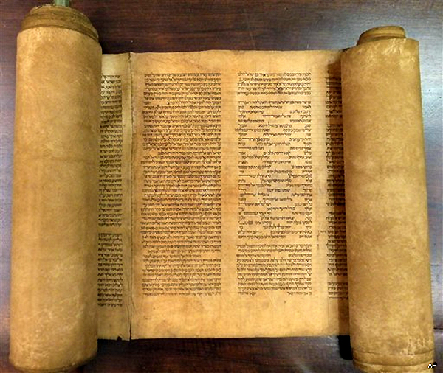
The Pentateuch
(Gk.) “five scrolls”
First 5 books of the Jewish Bible:
Genesis
Exodus
Leviticus
Numbers
Deuteronomy
Considered as the Torah
Notes:
Jews consider these books to be central to their law and their teaching and handing on of the faith.
Originally thought to be authored by Moses, but biblical scholars now agree it has multiple authors, but doubtful Moses was one of them.
Includes first 5 books …
Genesis: Creation, early world
Exodus: Exile and freedom to the Promised Land
Leviticus: Bringing order to the new land
Numbers: name comes from the two census’s taken in Israel as the culture grows. Summarizes first three books.
Deuteronomy (second law): three final speeches of Moses before the people enter the Promised Land.
Since all these either lead to, present, or define the parameters of the law … they are considered the Torah – book of the law

Slide 15
Other Books of the Old Testament
Isaiah: Comfort and encourage the Jewish people in exile
Psalms: Songs of praise, fear, sorrow, etc.
Proverbs: The wisdom of God

Slide 16
Two Creation Accounts???
What were the circumstances of the people during the time in which the story was written?
What was the literary form of the each creation account?
Is there any evidence that the story is historically factual?
If not historically factual, then where might the author/s have drawn from to create the story?
What was God trying to teach us through this story? What is the main message?

Slide 17
Evolution says …
The universe originated by natural processes over billions of years
Living things can arise from non-living things
God played no role in Creation
Simple organisms give rise to more complex organisms which in turn, produce even more complex offspring

Slide 18
Creation says …
The universe, both material and spiritual aspects, was created by God out of nothing
God used evolution as a tool to guide the development of new species
Man was made in the image and likeness of God out of love
The universe is still developing according to God’s divine plan of design

