Slide 1
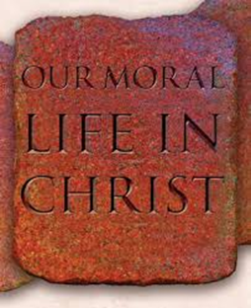
INTRODUCTION

Slide 2
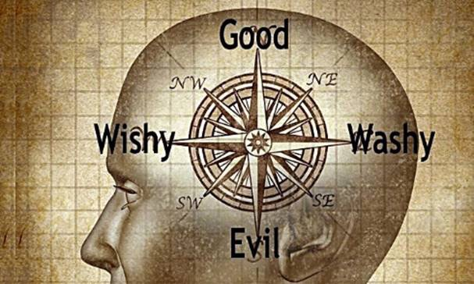
What is your …
moral compass?

Slide 4
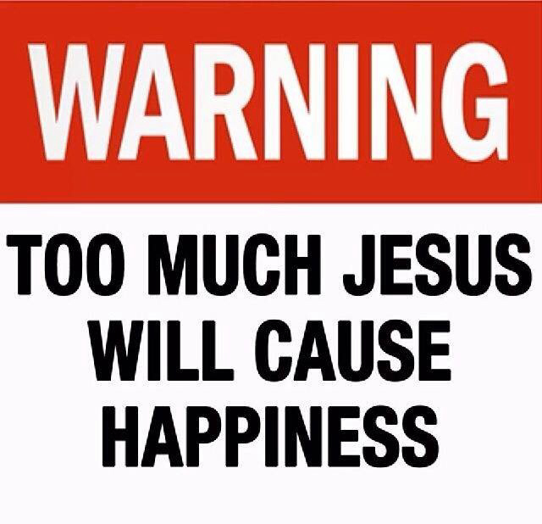

Slide 6
Personal or Societal?
Pornography
Adultery
Cheating
Euthanasia
War and violence
Stealing
Environmental pollution
Drug & alcohol abuse
Abortion
Human cloning

Slide 8
What is Morality?
Hemingway … “About morals, I know only that what is moral is what you feel good after, and what is immoral is what you feel bad after.”
What is morality to you?
Morality defined …
Knowing what ought to be done

Slide 9
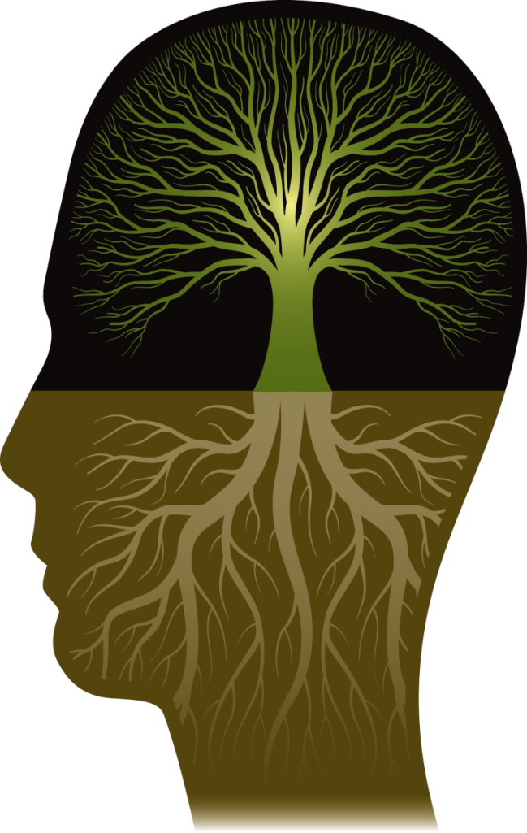
Catholic Morality: Three main sources of knowledge…
Human reason
Human experience
Divine Revelation

Slide 11
I am the LORD your God. You shall worship the Lord your God and Him only shall you serve.
You shall not take the name of the Lord your God in vain.
Remember to keep holy the Sabbath day.
Honor your father and your mother.
You shall not kill.
You shall not commit adultery.
You shall not steal.
You shall not bear false witness against your neighbor.
You shall not covet your neighbor’s wife.
You shall not covet your neighbor’s goods.

Slide 12
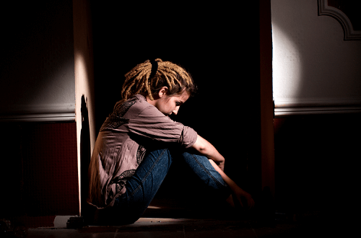
Character is…
…what a person is
in the dark

Slide 13
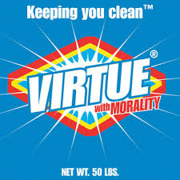
Our character is revealed through our virtues and vices.
Virtue = habit of choosing good
Vice = the opposite of virtue; bad habits
TWO MAJOR CATEGORIES OF VIRTUES:
Theological
Cardinal

Slide 14
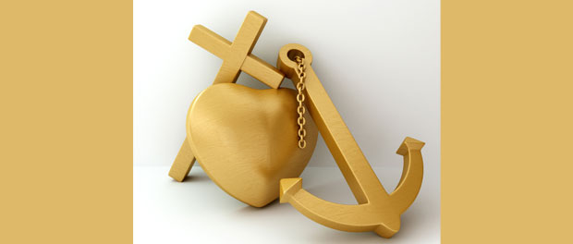
Theological Virtues
Gifts from God that empower us to do good
God-given .. Infused into our souls
FAITH
HOPE
LOVE

Slide 15
Cardinal Virtues
WHAT? Virtues that we can acquire by our own human efforts
PURPOSE? Help us to choose good, and then follow the right course of action
Also known as moral or human virtues because when we perform morally good acts, virtues become good habits that help us draw closer to God …
… and to relate to other people with Christ-like love.

Slide 16
Reflect & Journal …
List adjectives that I believe others would use to describe me.
List adjectives that best describe the real ‘me’ … in the dark.
What are some factors that cause me to make decisions I’m not proud of?
Who is the person I believe to be of the most consistent character I know, and why?
What gaps are there in my own character that prevent me from being that kind of person … ‘in the dark’?

