Slide 1
The beatitudes of Jesus
Gospel of Matthew

Slide 2
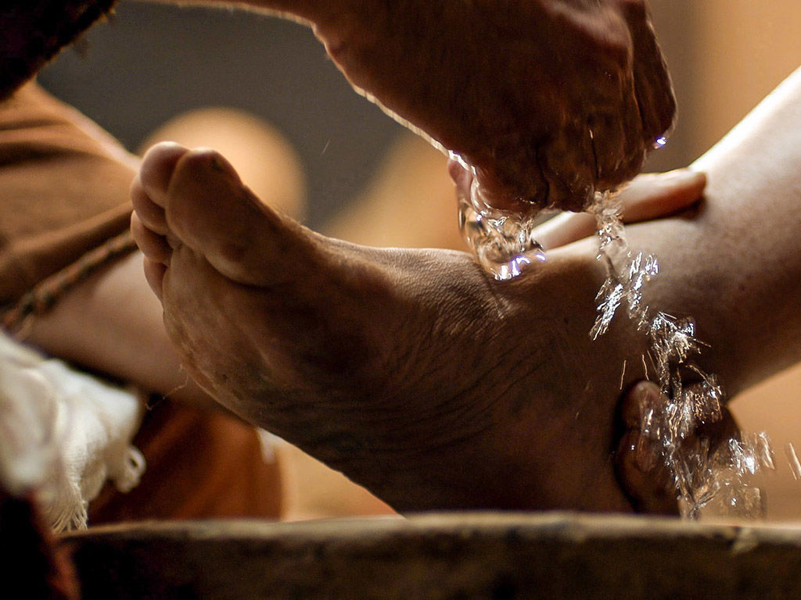
Blessed are the poor in spirit, for theirs is the kingdom of heaven …
Expresses humility
Recognizes that all we have/are is from God
To empty ourselves to the realization that we are totally dependent on God
We do not hoard, since all is gift
All we have is to be put at the service of others

Slide 3
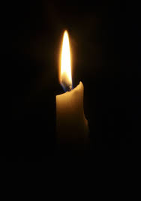
Blessed are they who mourn, for they will be comforted …
To mourn = “experience deep grief”
To be broken open …
We all know and understand loss
But do we ‘mourn’ our own sinfulness … when we willingly separate ourselves from God?
To do so is an act of humility
Mourning our sin leads to repentance, which in turn leads us back to God

Slide 4
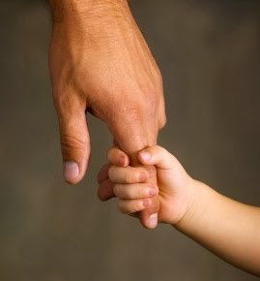
Blessed are the meek, for they will inherit the land …
Meek ≠ weak
Gentle, humble, simple in faith, patient in trial
Not self-centered
Acknowledges that everything is pure gift
Take my yoke upon you and learn from me, for I am meek and humble of heart; and you will find rest for yourselves. Mt 11:29
Behold, I am the handmaid of the Lord. May it be done to me according to your word. Lk 1:38

Slide 5
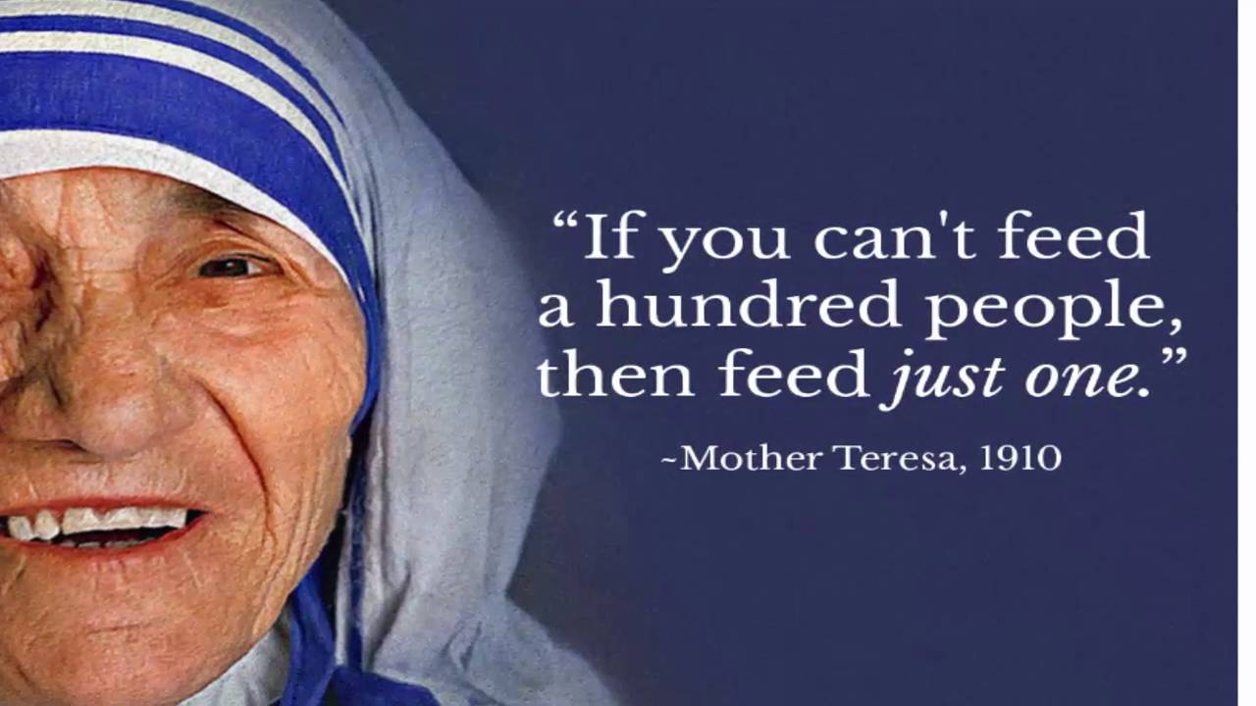
Blessed are they who hunger and thirst for righteousness …
… for they will be satisfied
Jesus isn’t talking about physical hunger and thirst
He’s referring to our passion for doing God’s will in our lives
To grow in holiness, justice, and truth

Slide 6
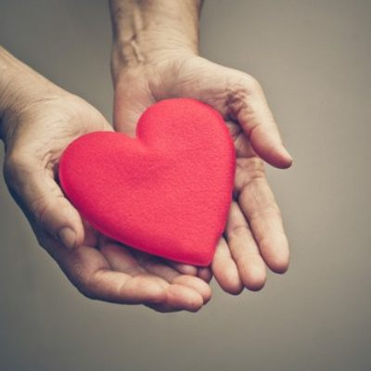
Blessed are the merciful, for they will be shown mercy …
Who has never been shown mercy?
Compassion, understanding, forgiveness
Hate the sin … love the sinner

Slide 7
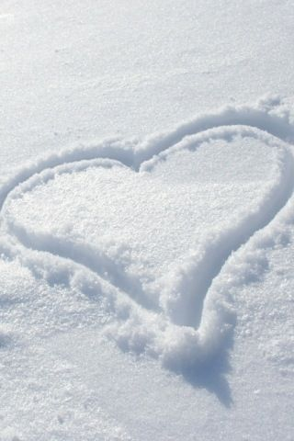
Blessed are the clean (pure) of heart, for they will see God …
“Pure” (Gk.) means ‘clean, blameless, free of guilt’
Not just an external show of piety, but a deep, internal conviction of loving God above all things
Ps 51:10, ‘A clean heart create for me, O God; renew within me a steadfast spirit.’

Slide 8
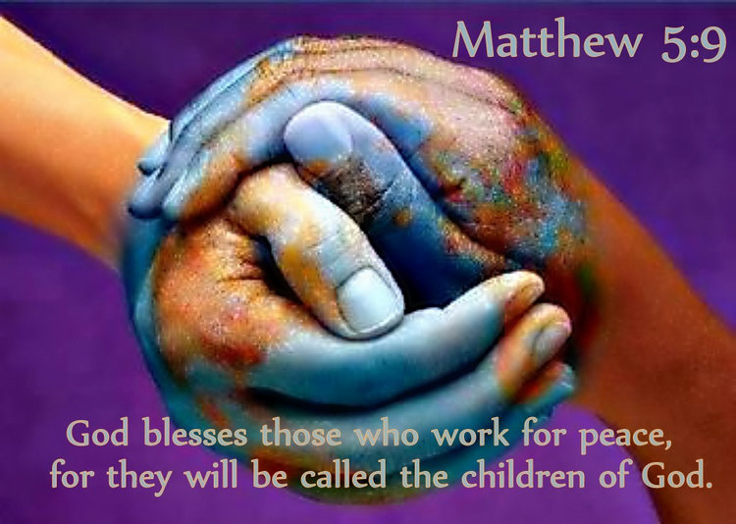
Blessed are the peacemakers, for they will be called children of God
The ultimate expression of peace … Jesus laid down his life in order to reconcile us back to the Father
When we carry that message to others … we are peacemakers
True peace does not exist apart from God

Slide 9
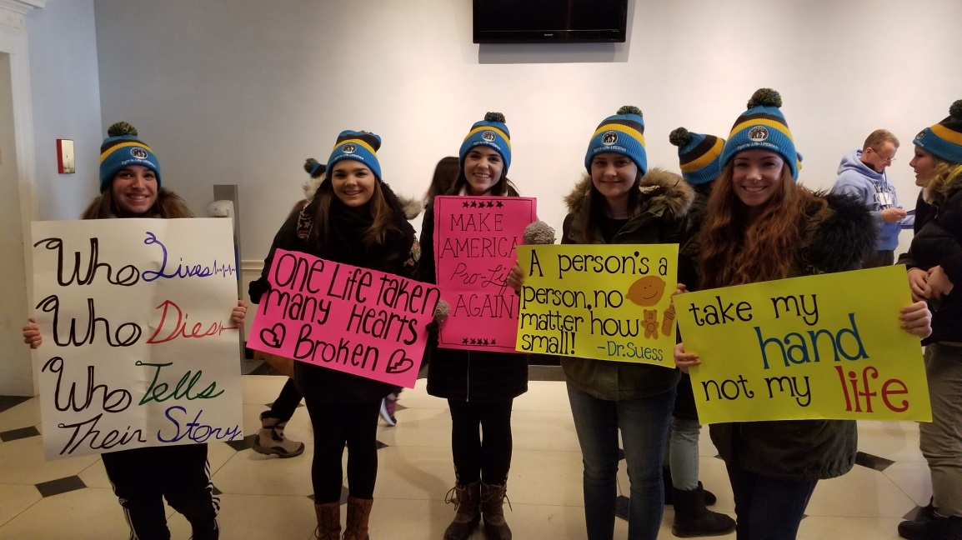
Blessed are those who are persecuted for the sake of righteousness …
… for theirs in the kingdom of heaven
Being fearless in sharing the faith with others, no matter the consequences
Unrighteous behavior is not blessed
Being fearless in defending the faith requires great TRUST in God

